Slide 1
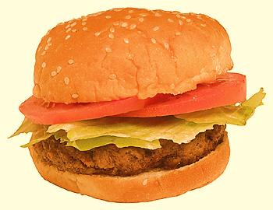
You are What You Eat!
Objective: To learn the various types of organisms within an ecosystem
Bell work: 2/28/19 Write words & definitions & give an example---page 71 ISN
1. DEFINE and give an EXAMPLE for:
a. Herbivore
b. Carnivore
c. Omnivore
d. Decomposer
2. Compare an autotroph with a heterotroph.
plant eater (Ex: Deer)
meat eater (Ex: Wolf)
eats both plants and animals (Ex. Bear)
breaks down dead material (Ex. Flies)
- Autotrophs (producers) make their own food
- Heterotrophs (consumers) can’t make their own food so they must eat it
© Getting Nerdy, LLC

Slide 2
There are two types of organisms – those that can make their own food, and those that get their food from other sources.
1. Producers/Autotrophs: get their energy from the SUN through the process of photosynthesis.
Sunlight
Carbon Dioxide
Enters Stomata (tiny holes) in leaves
Oxygen
Exits Stomata
Glucose Sugar
Stored
Water
Enters through Roots
© Getting Nerdy, LLC

Slide 3
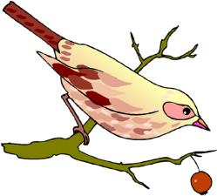
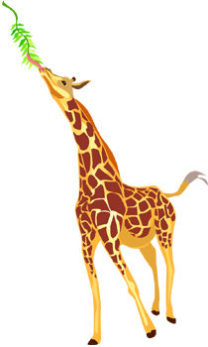
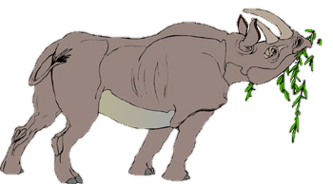
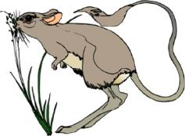
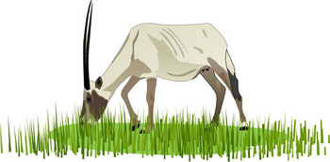
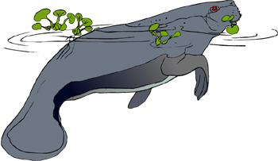
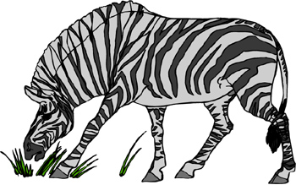
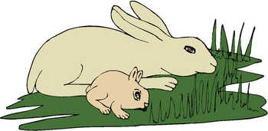
Consumers/Heterotrophs: get their food from other sources. There are 3 types:
Herbivores: eat only plants
© Getting Nerdy, LLC

Slide 4
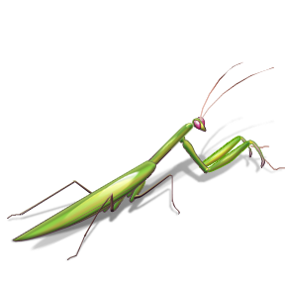
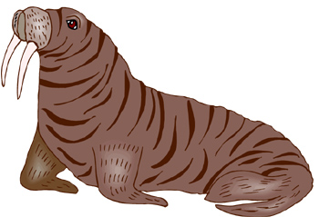
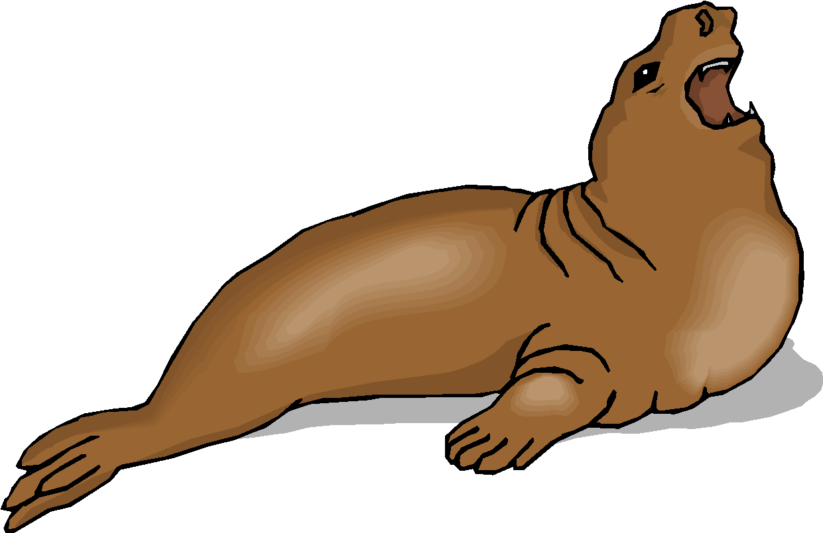
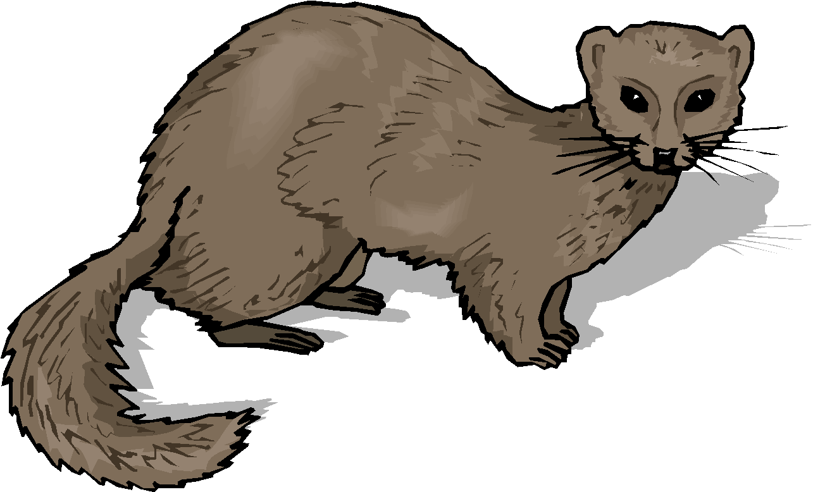
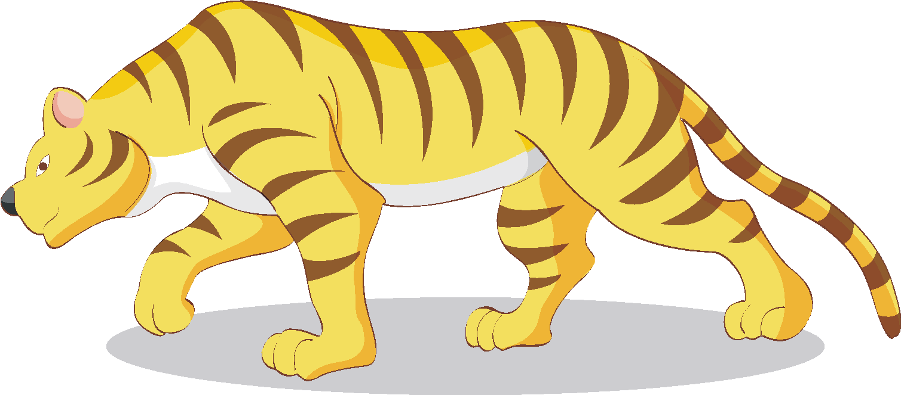
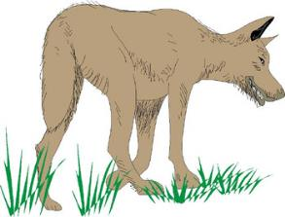
Carnivores: eat only animals
© Getting Nerdy, LLC

Slide 5
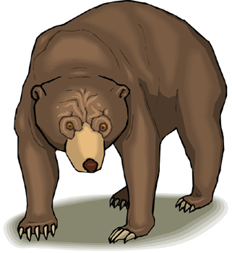
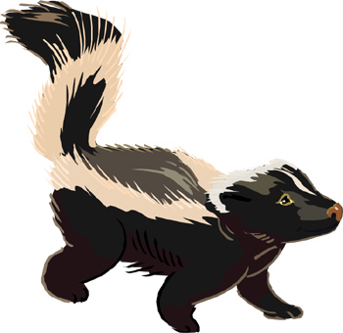
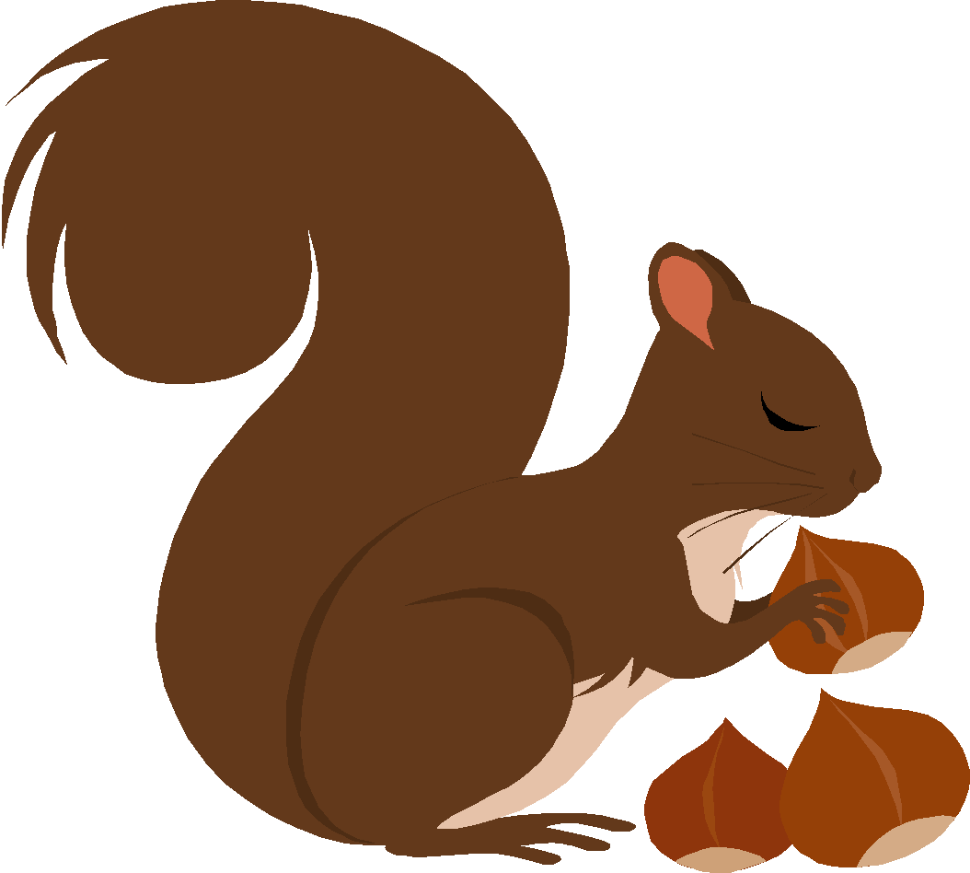
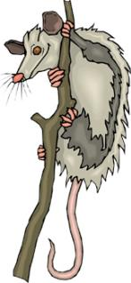
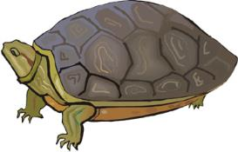
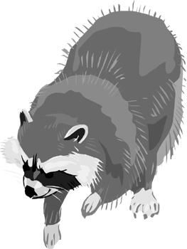
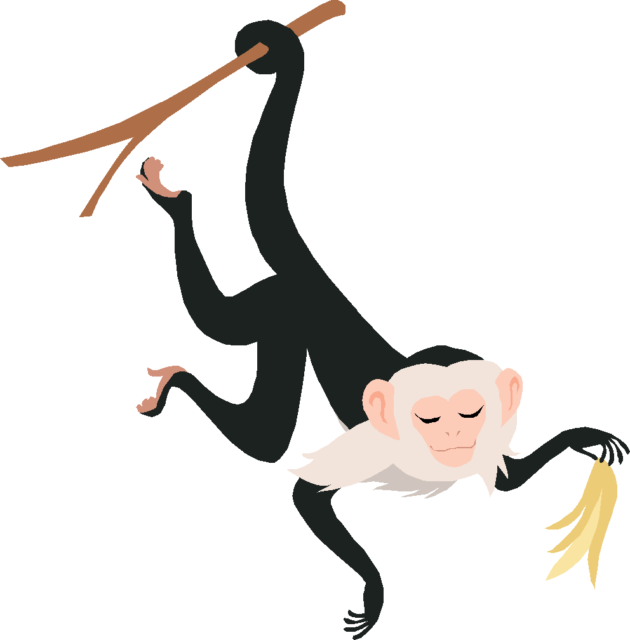
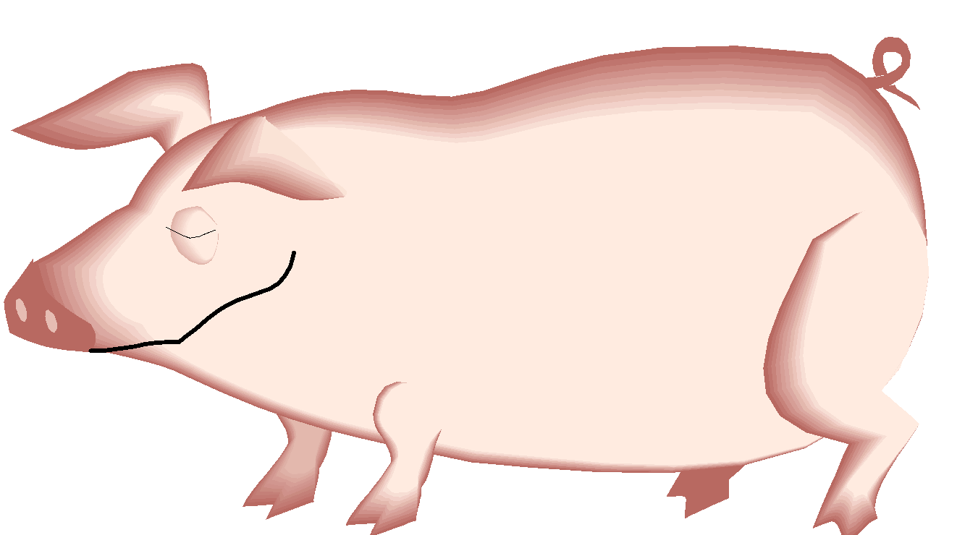
Omnivores: eats BOTH plants & animals
© Getting Nerdy, LLC

Slide 6
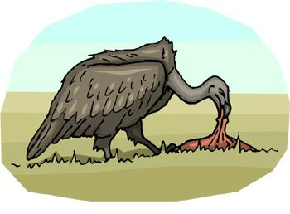
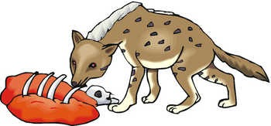
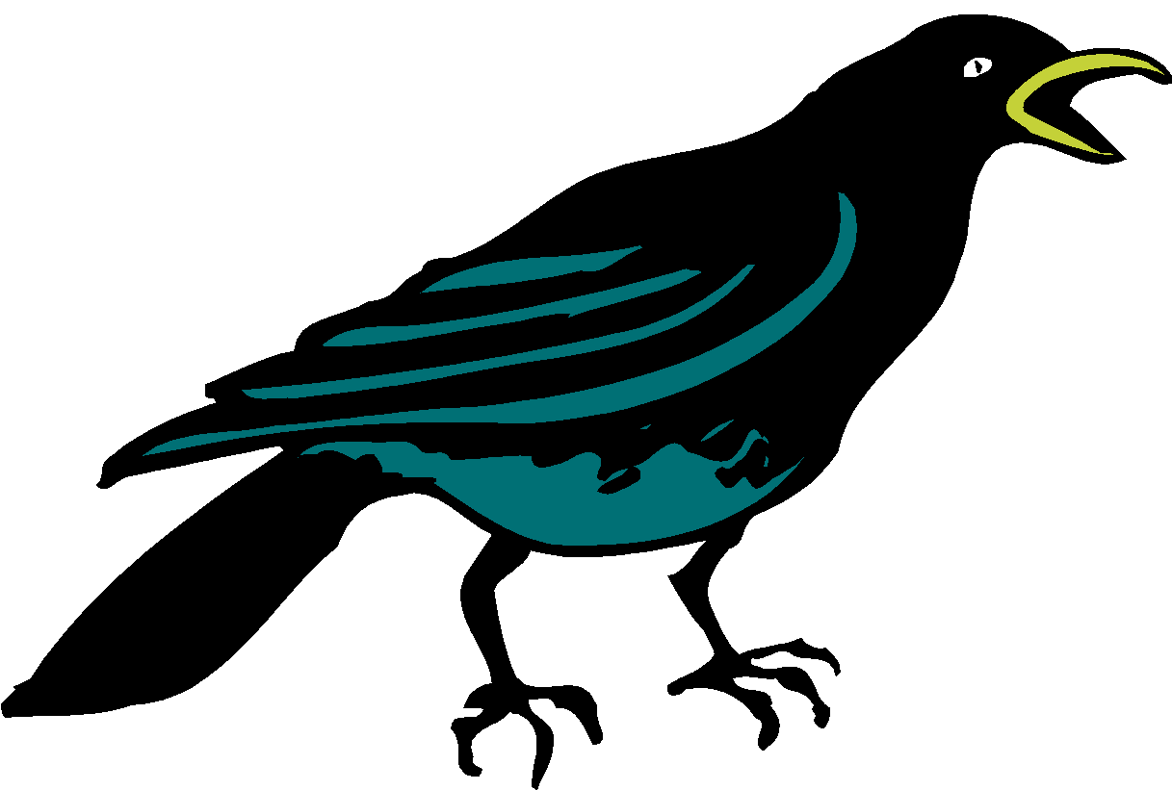
Scavenger: eats the leftovers
© Getting Nerdy, LLC

Slide 7
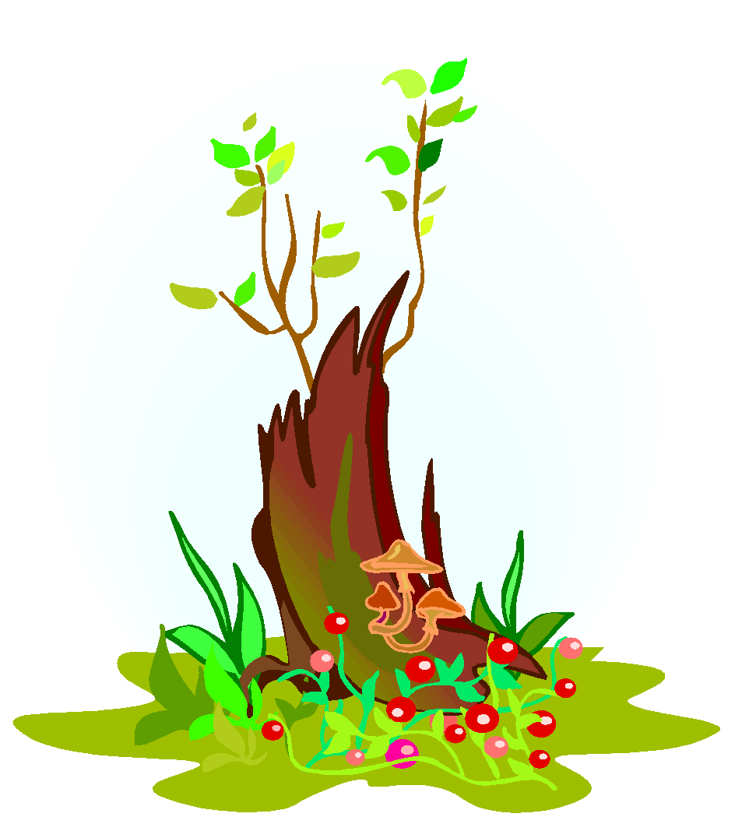
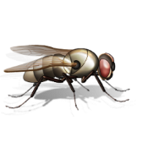
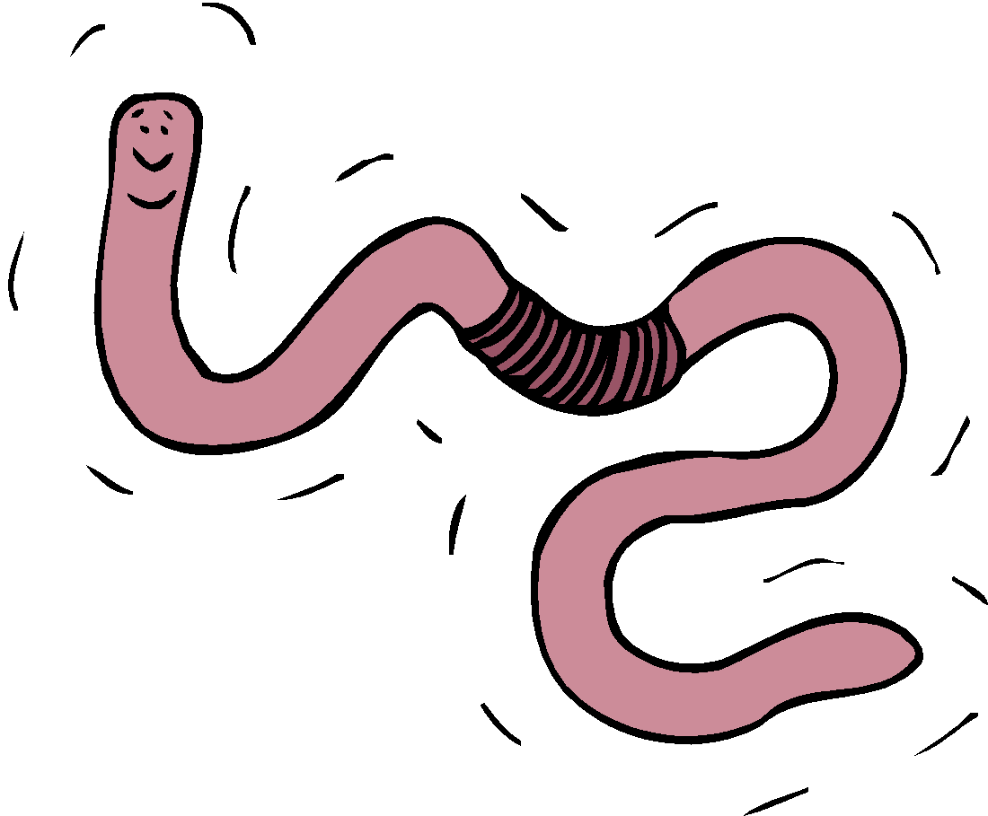
Decomposer: breaks down decaying material
© Getting Nerdy, LLC

Slide 8
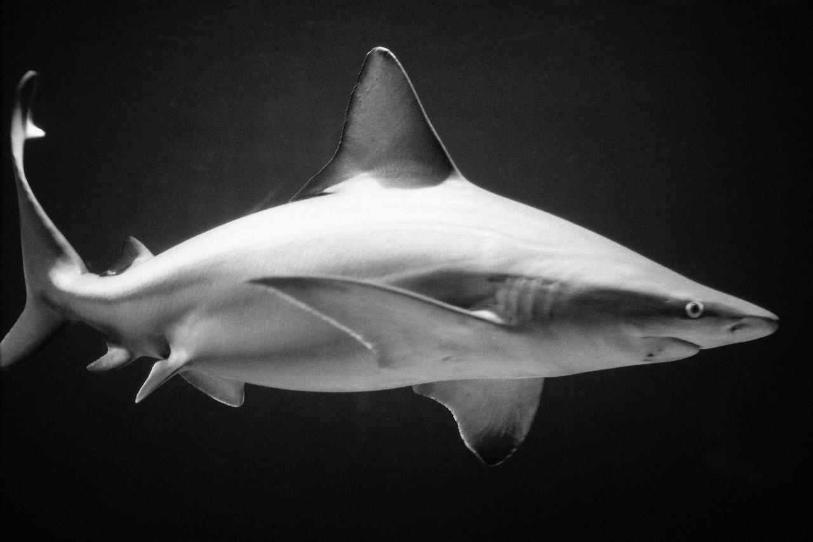
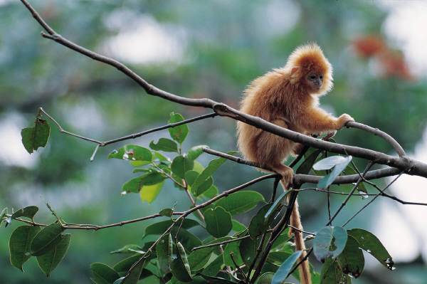
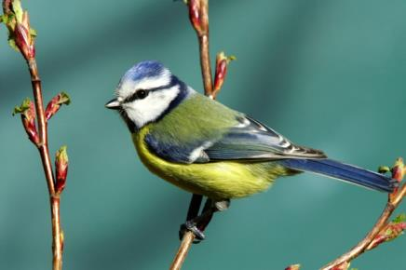
Do you know how these organisms get THEIR energy?
Carnivore, Herbivore or Omnivore??
Producer, Consumer or Decomposer??
© Getting Nerdy, LLC

Slide 9
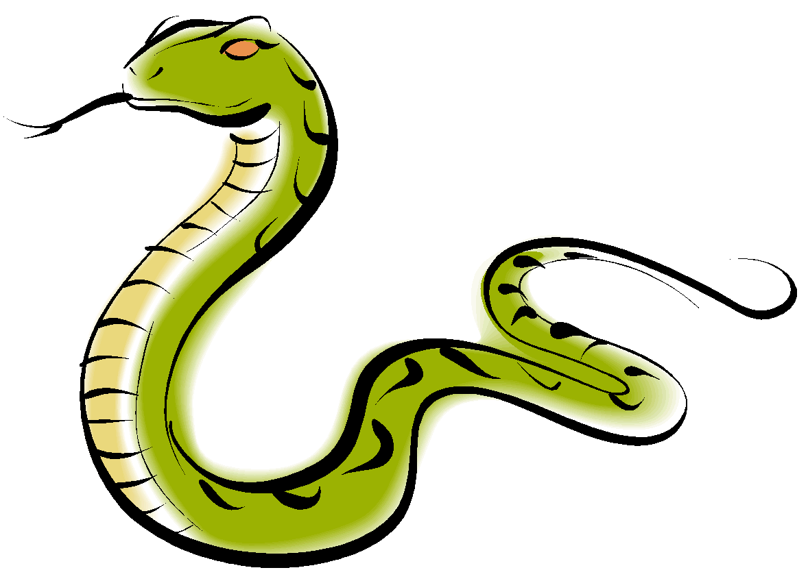
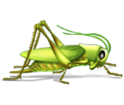
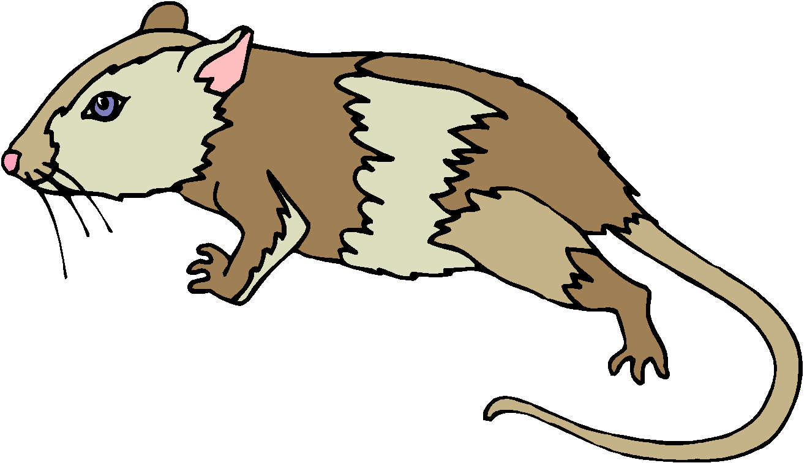
You are what you eat!
Identify each organism in the diagram below and label each as a producer, decomposer, herbivore, carnivore or omnivore.
What do you think the direction of the arrow between each organism means?
strawberry – producer; grasshopper – herbivore;
mouse – omnivore; snake – carnivore; hawk – carnivore;
mushrooms - decomposer
energy moves in the direction of the arrow – from the organism being eaten, to the one that is eating it
nutrients
© Getting Nerdy, LLC

Slide 10
Food Chain: series of events in which one organism eats another and obtains energy. Each level is a “trophic” level.
Begins with light energy from the SUN.
© Getting Nerdy, LLC

Slide 11
Producers: make food (glucose) using the sun’s energy through photosynthesis:
6CO₂ + 6H₂O + sunlight & chlorophyll →C₆H₁₂O₆ + 6O₂
Sunlight
Carbon Dioxide
Enters Stomata (tiny holes) in leaves
Oxygen
Exits Stomata
Glucose Sugar
Stored
Water
Enters through Roots
© Getting Nerdy, LLC

Slide 12
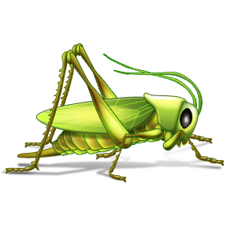
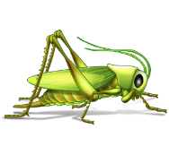
Primary (1st) Consumer: eats producers/plants and can be an
Herbivore OR Omnivore
© Getting Nerdy, LLC

Slide 13
Secondary (2nd) Consumer: a carnivore or omnivore eats the primary consumer
OR
© Getting Nerdy, LLC

Slide 14
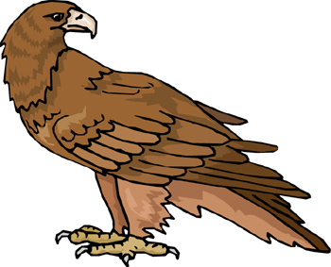
Tertiary (3rd) Consumer: eats primary or secondary consumers.
Called the “top of the food chain”
OR
© Getting Nerdy, LLC

Slide 15
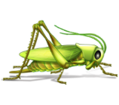
Who feeds on EVERYTHING?
Scavenger: Carnivore that feeds on dead organisms.
Decomposers: break down decaying material and release nutrients into soil
Can you tell the difference between herbivores, carnivores, producers, decomposers, and scavengers within Africa?
nutrients
© Getting Nerdy, LLC

Slide 16
Food Chain!
nutrients
Organisms use the energy released in the food chain to power all of their daily activities through the process of cellular respiration.
© Getting Nerdy, LLC

Slide 17
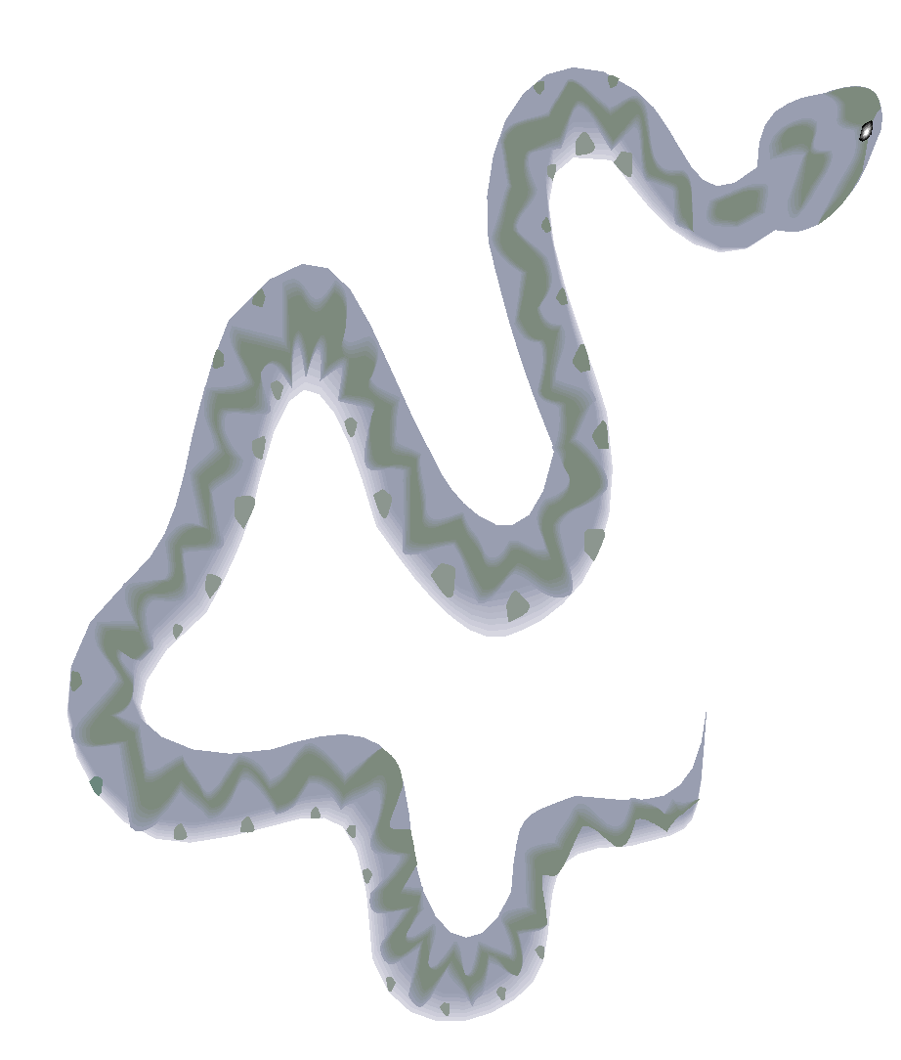
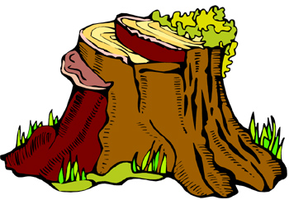
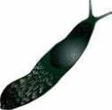
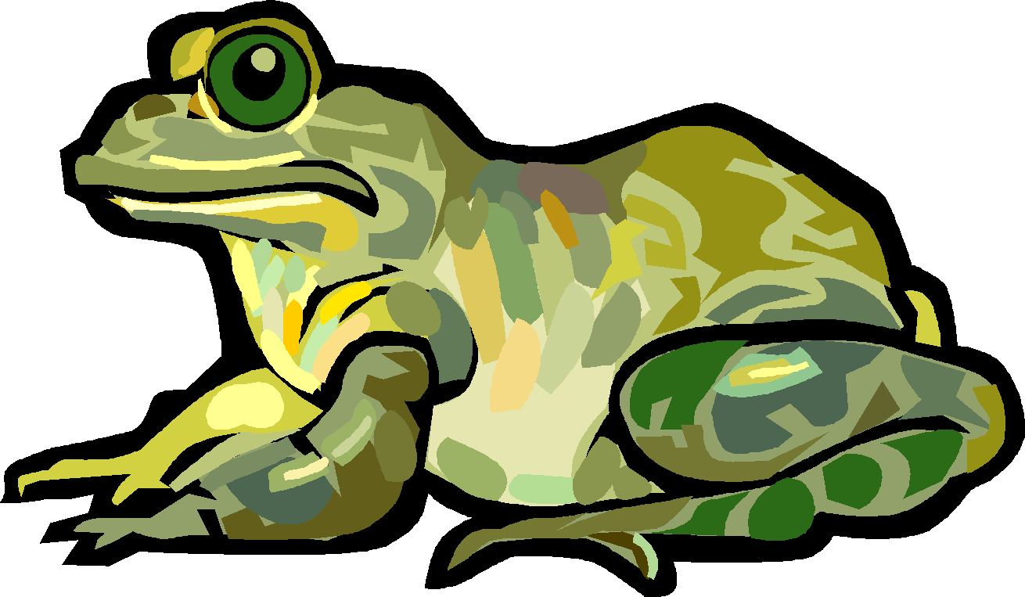
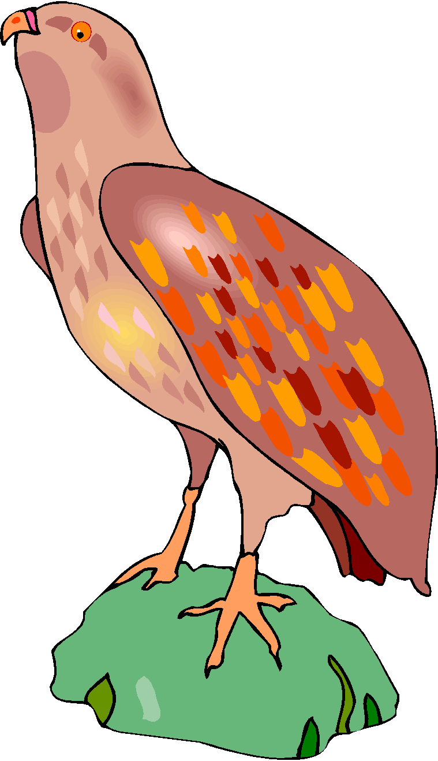
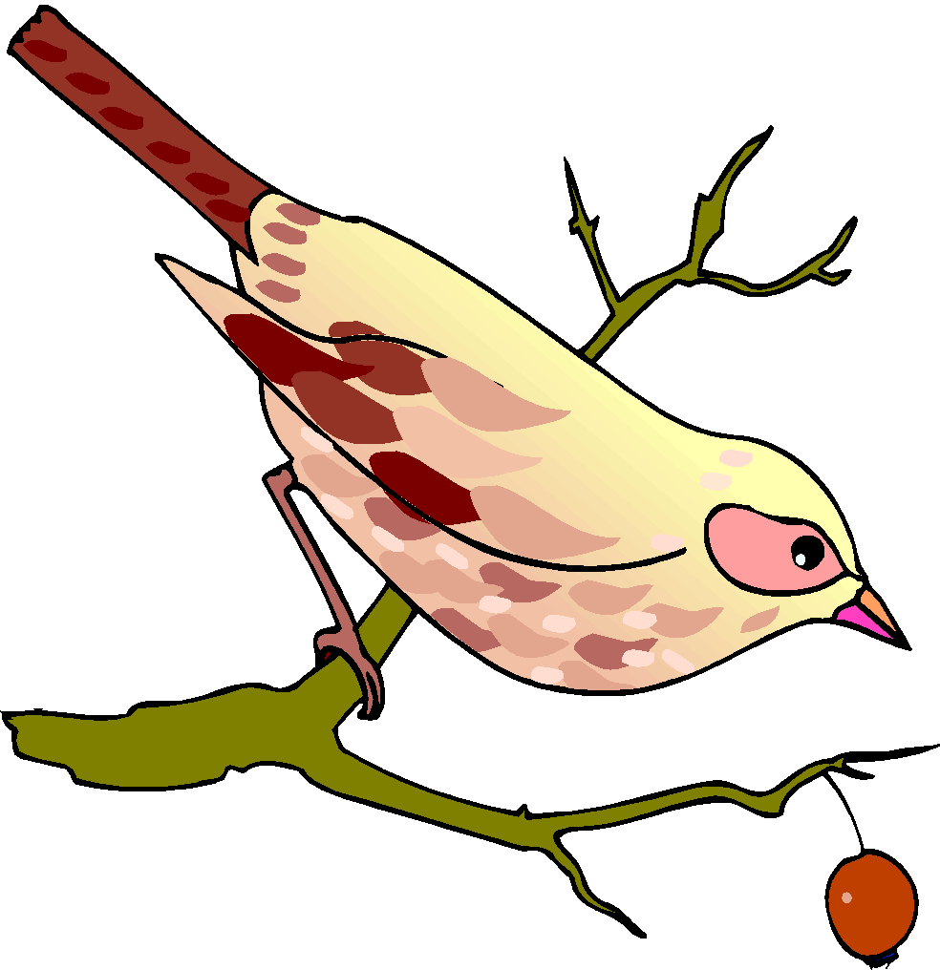
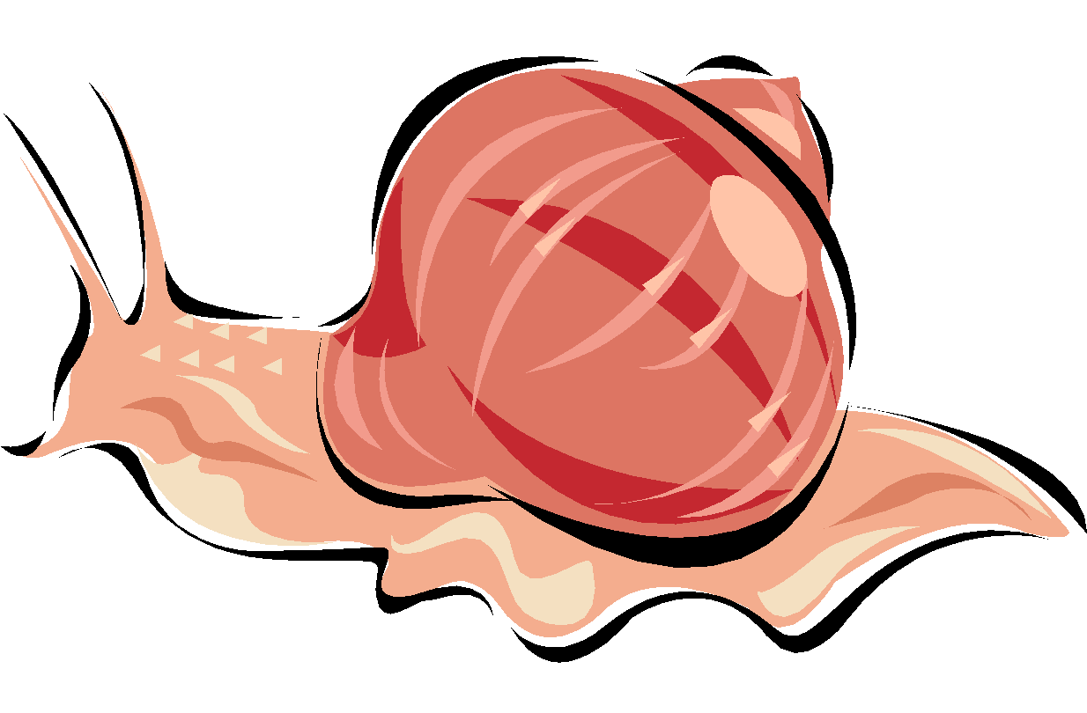
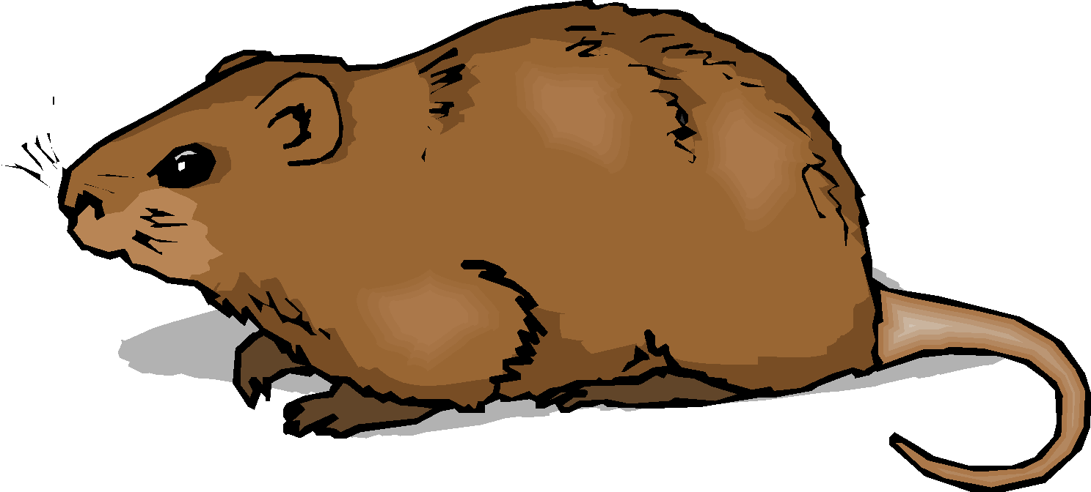
More Food Chains!
© Getting Nerdy, LLC

Slide 18
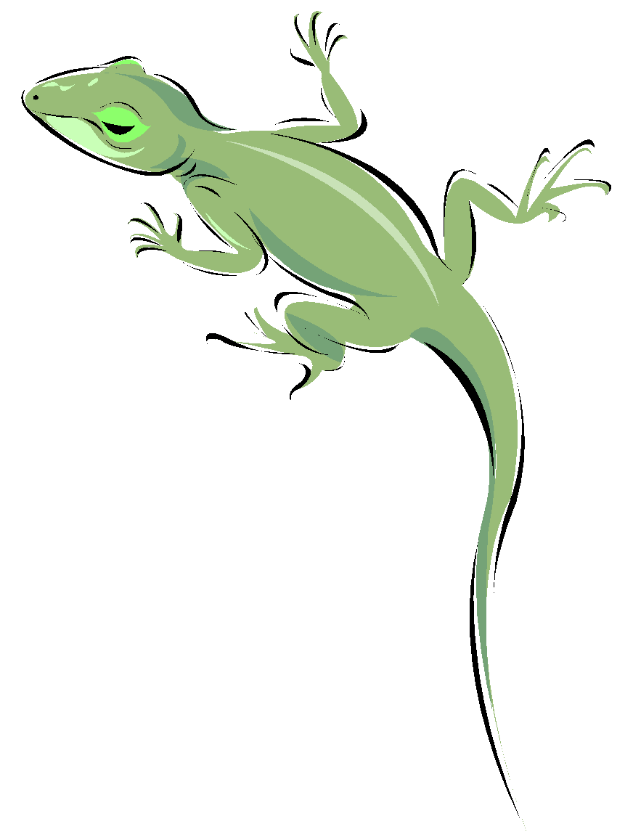
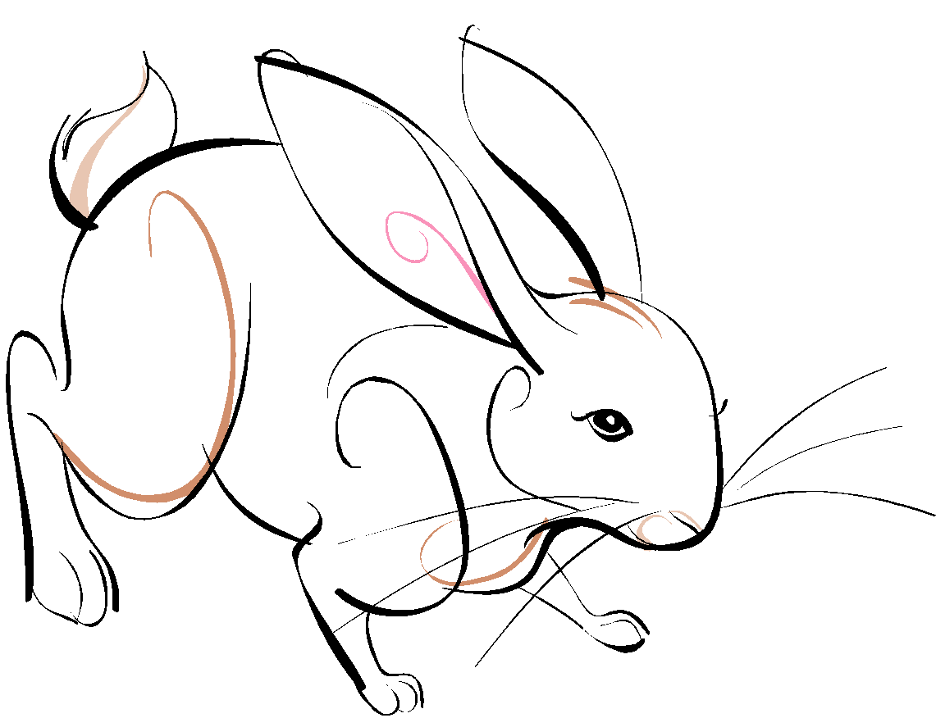
Food Web: many overlapping food chains in an ecosystem. Shows how ALL organisms interact within the ecosystem
Food Web
Food Chain
© Getting Nerdy, LLC

Slide 19
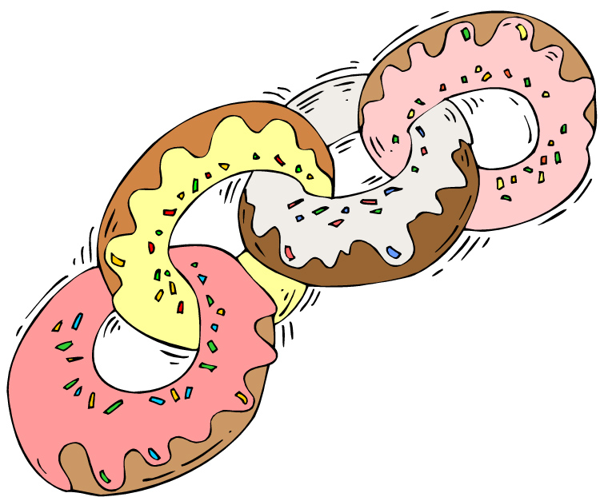
Food Chain & Web Games!
Simple starter food chain
Food Chain by I Know that!
Build a food chain
Ecosystem food chains
Woodland Food Web
Fun with Food Webs
HA! HA!
© Getting Nerdy, LLC

