Slide 1
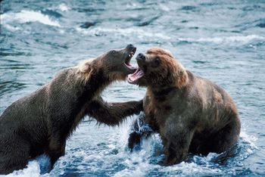
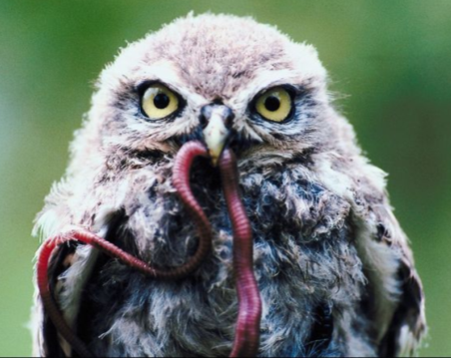
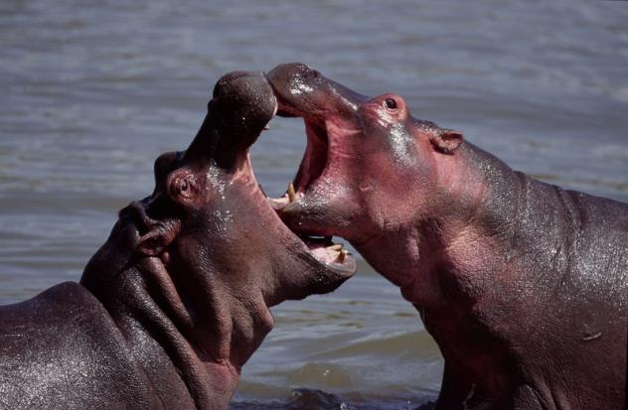
Why Can’t We All Just Get Along?
Objective: To explain the types of relationships that exist between organisms
Bell work: Define the following terms in your own words:
Competition:
Predator:
Prey:
To fight for a resource
The organism that hunts
The organism that gets eaten
© Getting Nerdy, LLC

Slide 2
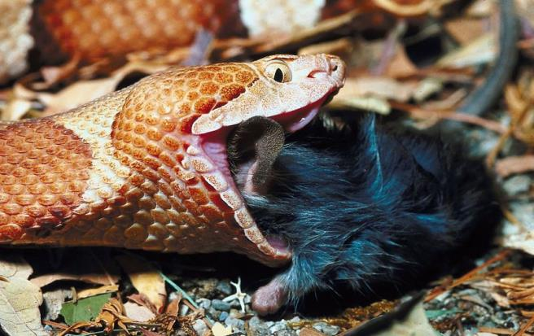
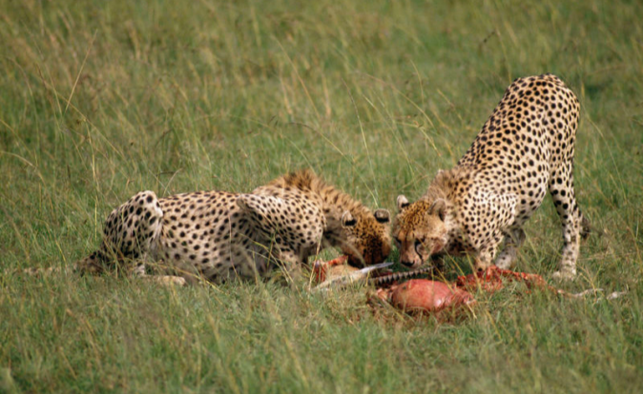
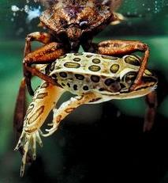
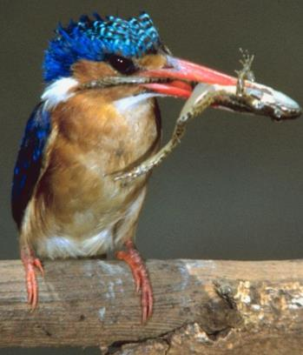
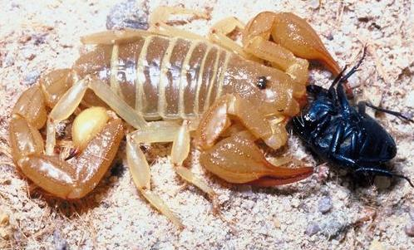
Predation: interaction where one organism (predator) kills another organism for food (prey)
© Getting Nerdy, LLC

Slide 3
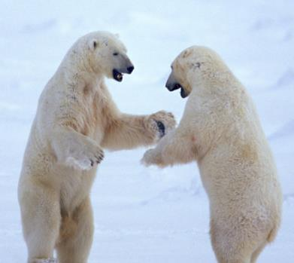
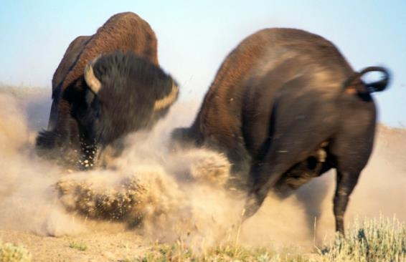
Competition: struggle between organisms to survive as they attempt to use the same limited resource
© Getting Nerdy, LLC

Slide 4
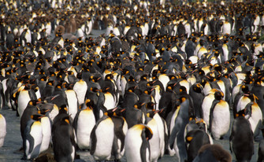
Limiting Factors of Ecosystems Limiting factor: an environmental condition or resource that limits the size of a population of organisms.

Slide 5
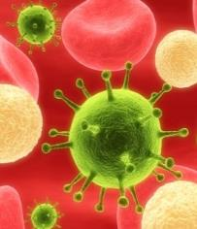
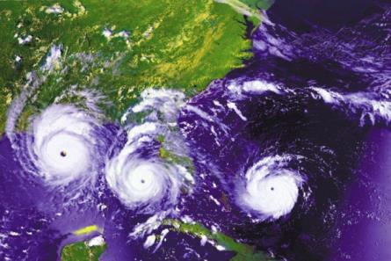
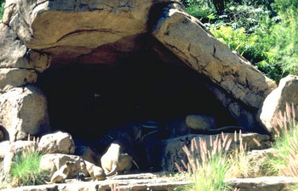
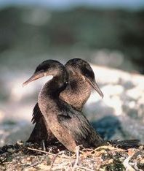
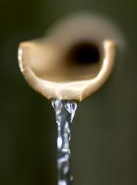
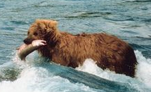
Limiting Factors of Ecosystems
Limiting factor: an environmental condition or resource that limits the size of a population of organisms.
What are examples
of limiting factors?
-Food
-Water
-Weather
-Accidents
-Natural Catastrophe
-Disease
-Predators
-Space/Habitat
-Mate
-Competition
The largest population an area can support is its carrying capacity which is driven by limiting factors.
© Getting Nerdy, LLC

Slide 6
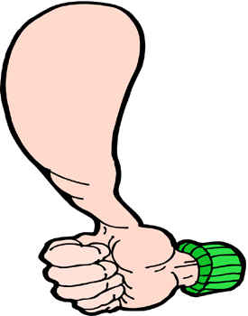
Interactions of Living Things
Symbiosis: close relationship created between two species due to coevolution (species evolve together in their environment).
The relationship must benefit at least one of the species.
=
?
OR
© Getting Nerdy, LLC

Slide 7
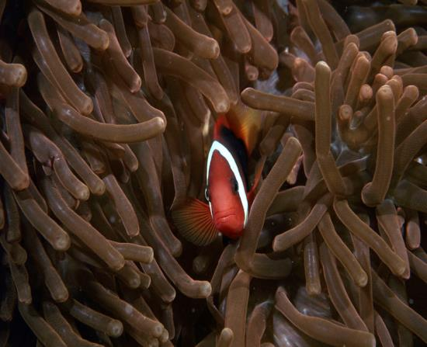
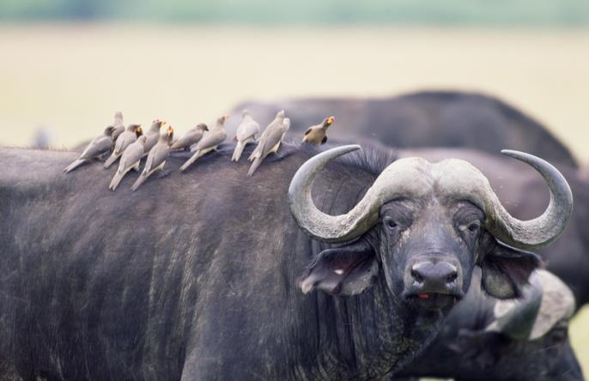
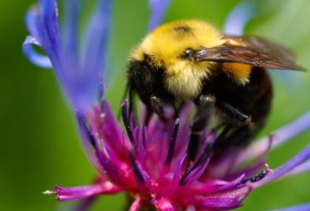
There are three types of symbiotic relationships:
Mutualism (+,+): relationship where both species benefit
Clownfish & Sea Anemone
Buffalo & Tickbird
© Getting Nerdy, LLC
Bumblebee & Flowers

Slide 8
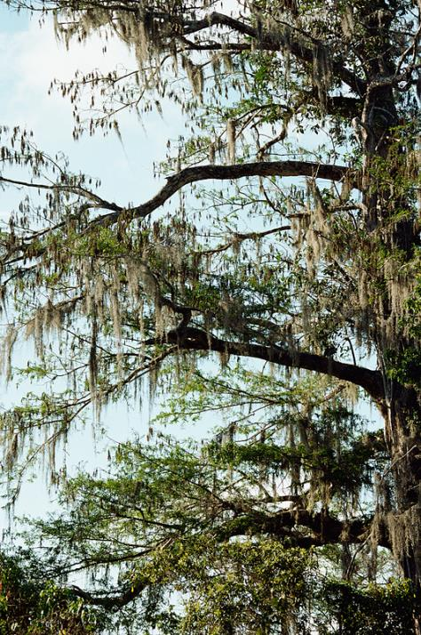
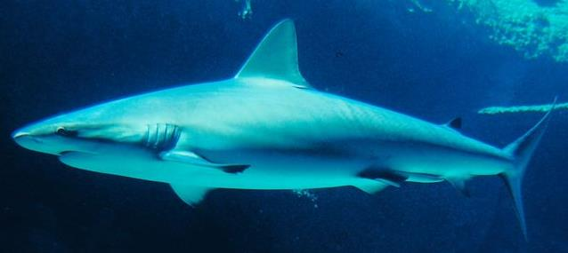
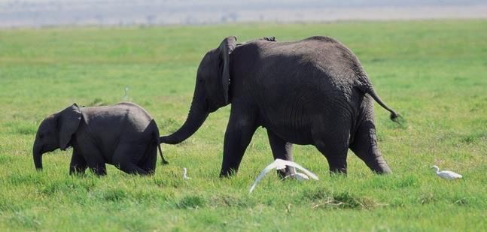
Commensalism (+,0): relationship where one species benefits and the other species is neither helped nor harmed
Shark & Remora
Spanish Moss & Trees
Elephant & Egret
© Getting Nerdy, LLC

Slide 9
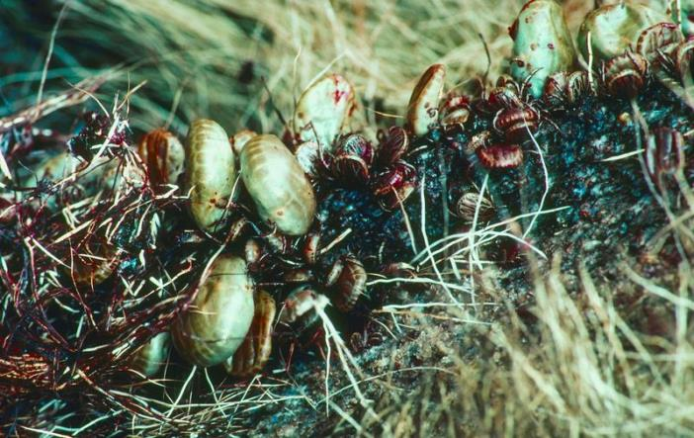
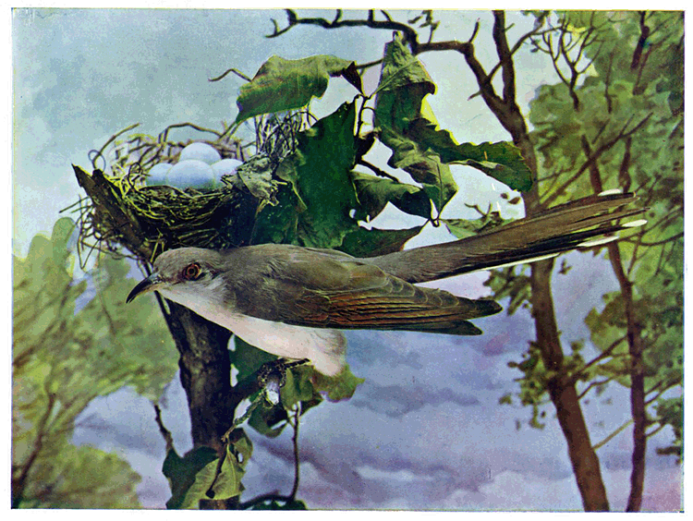
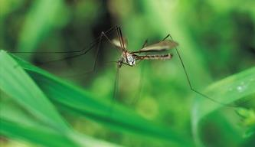
Parasitism (+,-): relationship where one species benefits (parasite) while the other is harmed (host)
Ticks & Mammals
Cuckoo Bird & Bird Nests
© Getting Nerdy, LLC
Mosquitoes & Mammals

