Slide 1
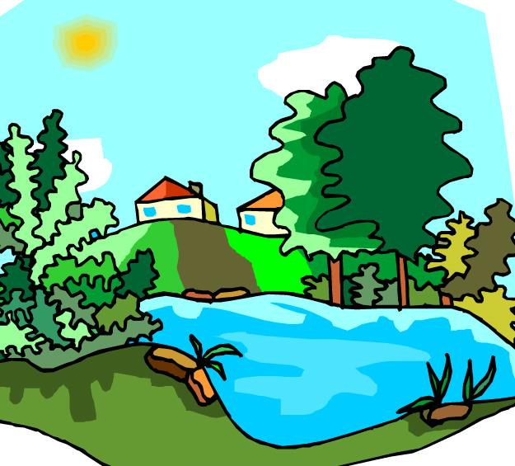
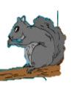
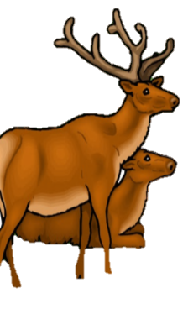
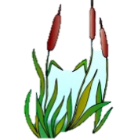
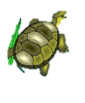
What’s in an Ecosystem? Pg. 67 ISN
It’s a Frog’s World…
Objective: to determine how organisms are organized by their interactions
**Write questions & answers
Bell work:
What is the smallest unit of living things?
What does the prefix “bio” mean?
List two living factors and two non-living factors of the ecosystem shown.
Cells
Life
aaa
© Getting Nerdy, LLC

Slide 2
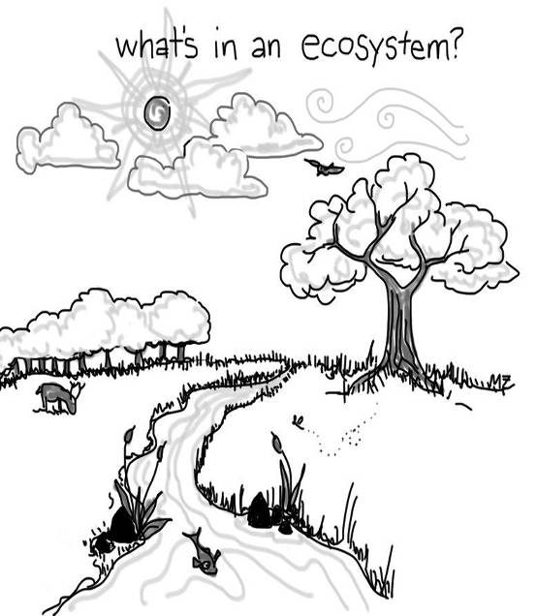
Ecology: the study of how living things interact with each other and their environment. Every living thing is made of cells!
An ecosystem is made up of all of the living (BIOTIC) and non-living (ABIOTIC) factors.
In the picture, place a CIRCLE AROUND things that are LIVING and an “X” over things that are NON-LIVING.
© Getting Nerdy, LLC

Slide 3
Atoms
Molecules
Organelles
Cells
Tissues
Organs
Organ Systems
Organisms
Populations
Communities
Ecosystems
Biosphere
The Universe
All of science builds upon levels: every living organism is made up of CELLS - tiny living units that can live alone (unicellular) or combine to make more complex things like tissues, organs, organ systems and organisms (multicellular); hence, the Levels of Organization.
ORGANISMS are organized into levels by how they interact with one another, which will take us into the Levels of Organization for Ecology. We have several types of organisms, and their type tells us how the organisms interact.
© Getting Nerdy, LLC

Slide 4
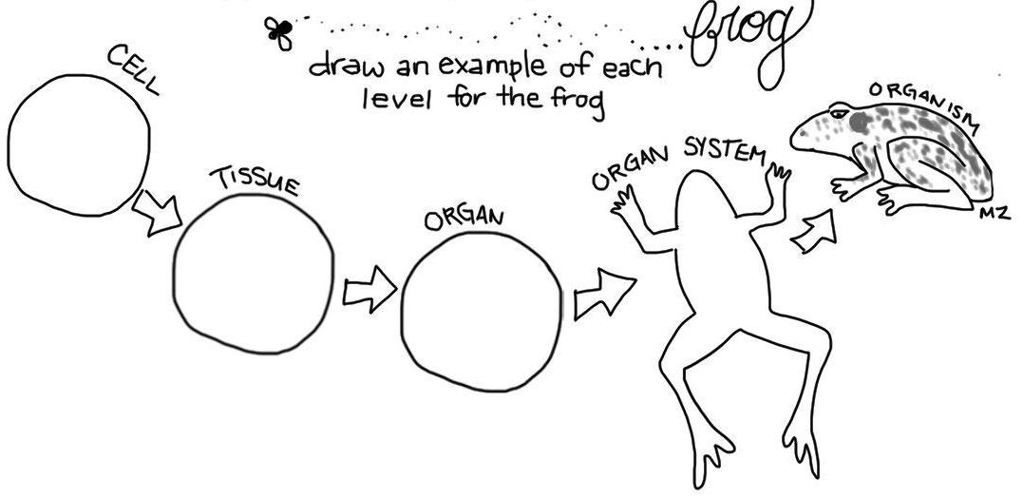
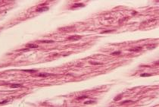
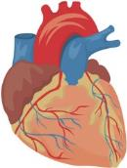
Now, create your own levels of organization for the frog. Each level must build upon the previous level. For example, if you draw a cardiac muscle cell, then you should draw cardiac muscle tissue, a heart, & the cardiovascular system.
Cellular level (muscle cell)
Organism level (consisting of many organ systems)
Organ system level (cardiovascular system)
Tissue level (muscle tissue)
Organ level (heart)
© Getting Nerdy, LLC

Slide 5
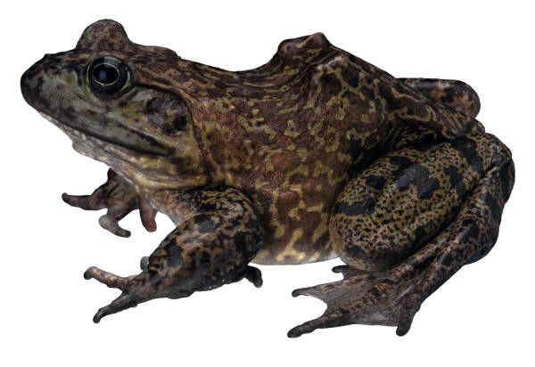
Levels of Organization
Organism: a single living thing that obtains food, water, and shelter to live, grow, and reproduce in its habitat (environment). An organism’s niche is its total way of life.
Ex: frog
© Getting Nerdy, LLC

Slide 6
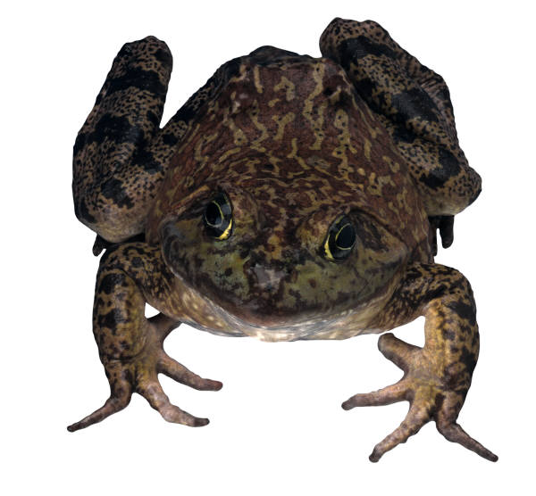
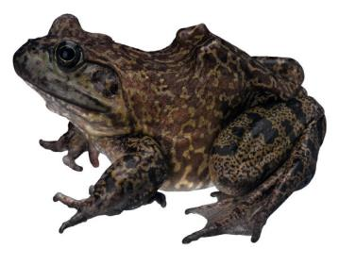
Population: A group of interbreeding organisms (species) living in the same area
Ex: All of the frogs living in a pond behind your neighborhood
© Getting Nerdy, LLC

Slide 7
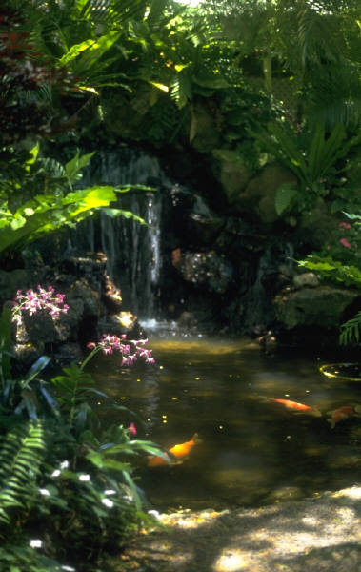
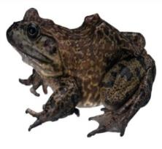
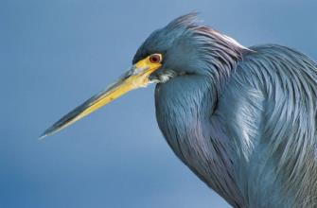
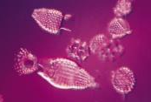
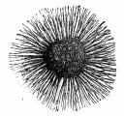
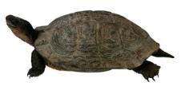
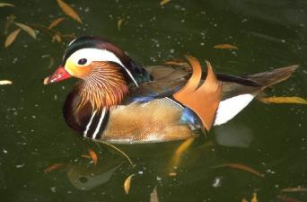
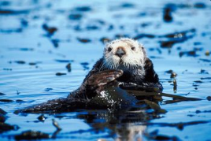
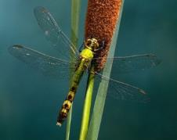
Community: all the populations in an ecosystem
Ex: All the frogs, insects, reptiles, birds, plants, mushrooms, bacteria, protists, mammals & fish living in the pond behind your neighborhood
© Getting Nerdy, LLC

Slide 8
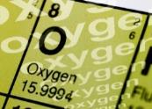
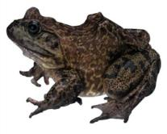
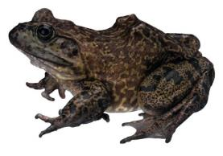
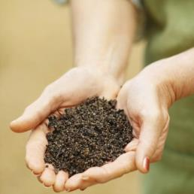
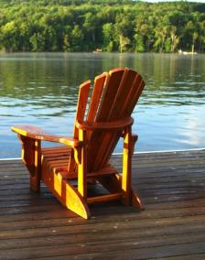
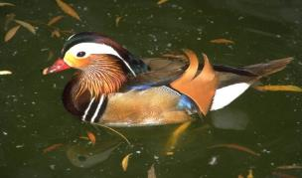
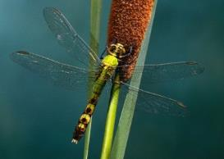
Ecosystem/Biome : Includes all the living (biotic) & nonliving (abiotic) features of an environment. There are several major types of ecosystems such as a rainforest, desert, tundra, deciduous forest, taiga, marine, etc.
Ex: All the frogs, insects, birds, reptiles, plants, mushrooms, bacteria, mammals & fish along with water, soil, air, clouds, sunlight, and man-made materials in the pond behind your neighborhood
© Getting Nerdy, LLC

Slide 9
Biosphere: every place on Earth that can support life
Atmosphere
Lithosphere
Hydrosphere
Atmosphere = air
Hydrosphere = water
Lithosphere = land
© Getting Nerdy, LLC

Slide 10
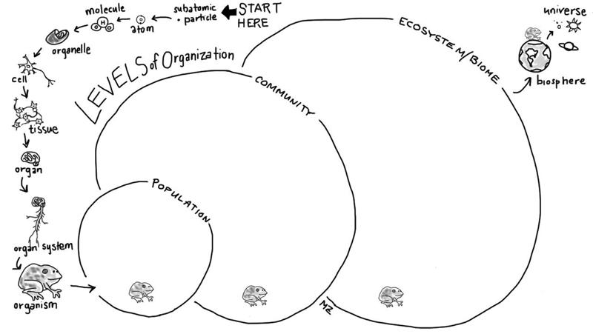
Page 68 ISN --- Now, use your frog to create each level. Fill out the circles with pictures of other frogs that will join your frog in its population, include the frog and other animals/plants/fungi/protists/bacteria in the community, and then all of the living & non-living things in the ecosystem.
© Getting Nerdy, LLC

