Slide 1
Date: 3/25/19----UNIT 6 Energy | HOMEWORK:
Please prepare for class. You will need: Planner OUT…or I will sign! | Science Starter: “DO NOWS” PLANNER…Keep planner out on desk….EVERY DAY…ALL DAY! Table of Contents on page 80 for Unit 6 Tab on page 80 Tear out pages 370-387. Staple, put name and period in a place that you can see it clearly! Lesson 1 Vocabulary….pictures and definitions. Show me for a grade and glue onto page 81 Begin answering packet….Active reading page 372-373, 374-379, 383-387----Due Wednesday
EQ # 1: page 81 ISN…How is energy conserved?
LESSON 1 LESSON 2 1-Energy transformation 4-kinetic theory of matter 2-Efficiency 5-temperature 3-Law of conservation of energy 6- degree 7-thermometer

Slide 2
Date | Standard | Topic ----- UNIT 5 | Page
3/25/19 | **** | TOC --- Table of Contents | 80
3/25/19 | **** | Unit 6 Lesson 1 & 2 Vocabulary | 81
3/26/19 | **** | Unit 6 Lesson 3 Vocabulary | 82
 | **** | Forms of Energy Match | 83
 | **** | Energy and Matter Foldable | 84
 | **** | Energy Transfer Foldable | 85
 | **** | Bill Nye Energy Transformation | 86

Slide 3
Date: 3/26/19----UNIT 6 Energy | HOMEWORK: Lessons 1 & 2 packet due Thursday!
Please prepare for class. You will need: Planner OUT…or I will sign! | Science Starter: “DO NOWS” PLANNER…Keep planner out on desk….EVERY DAY…ALL DAY! If you need a sticker for Lessons 1 & 2 Vocabulary, bring to me TODAY only! Lesson 2 Vocabulary….picture AND 1 example and definition of each. Show me for a grade and glue onto page 82----DUE TODAY FOR A GRADE OR TOMORROW FOR A STICKER ONLY….NO GRADE Begin answering packet….Active reading page 372-373, 374-379, 383-387----Due Thursday---TURN IN FOR A GRADE
EQ # 1: page 81 ISN…How is energy conserved?
Lesson 3 1-thermal energy 2-heat 3-conduction 4-conductor 5-insulator 6-calorie 7-convection 8-radiation

Slide 4
Date: 3/27/19----UNIT 6 Energy | HOMEWORK: Lessons 1 & 2 packet due Friday!
Please prepare for class. You will need: Planner OUT…or I will sign! | Science Starter: “DO NOWS” PLANNER…Keep planner out on desk….EVERY DAY…ALL DAY! If you need a sticker for Lessons 1 & 2 & 3 Vocabulary, bring to me TODAY only! Show me Lesson 3 for a grade today Begin answering packet….Active reading page 372-373, 374-379, 383-387----Due Thursday---TURN IN FOR A GRADE
EQ # 1: page 81 ISN…How is energy conserved?
Lesson 3 1-thermal energy 2-heat 3-conduction 4-conductor 5-insulator 6-calorie 7-convection 8-radiation

Slide 5
Date: 3/28/19----UNIT 6 Energy | HOMEWORK: Lesson 3 packet due Friday in class
Please prepare for class. You will need: Planner OUT…or I will sign! | Science Starter: “DO NOWS” PLANNER…Keep planner out on desk….EVERY DAY…ALL DAY! Video Review --- Forms of Energy Bill Nye Energy Transformation – pg 83 ISN Bill Nye Energy Transformations 4) Turn in Lessons 1 & 2 packet today! (372-373, 374- 379, 383-387) 5) Turn in the Video Review – Forms of Energy 6) Turn in Bill Nye Energy Transformations
EQ # 2: page 83 ISN…How is temperature related to kinetic energy?
Bill Nye Energy Transformations Video Review - Forms of Energy

Slide 6
Date: 3/29/19----UNIT 6 Energy | HOMEWORK: Lesson 3 packet due Friday in class
Please prepare for class. You will need: Planner OUT…or I will sign! | Science Starter: “DO NOWS” PLANNER…Keep planner out on desk….EVERY DAY…ALL DAY! Tear out pages 389 – 410. Staple and put name and period on it. Highlight and begin working on pages 393 – 395, 397, 398, 400, 401, 407-410 Turn in whatever you complete today….whether you are finished with it or not!
EQ # 2: page 83 ISN…How is temperature related to kinetic energy?

Slide 7
Date: 4/01/19----UNIT 6 Energy | HOMEWORK:
Please prepare for class. You will need: Planner OUT, ISN, glue boxes, scissors | Science Starter: “DO NOWS” PLANNER…Keep planner out on desk….EVERY DAY…ALL DAY! You should have 2 stickers so far on pages 81 and 82! FILL IN TOC FOR ALL PAGES!!!! Page 83 Forms of Energy….cut the pics out and place them by the correct form of energy. DO NOT glue these down until you have Mrs. A. check them. Page 84 ISN Energy and Matter….cut out and answer the questions…leave room to add information from Mrs. Adkins. Glue to page 84. Page 85 ISN Energy Transfer….cut out and answer the question for each pic…leave room for more info
EQ # 2: page 83 ISN…How is temperature related to kinetic energy?
Lesson 3 1-thermal energy 2-heat 3-conduction 4-conductor 5-insulator 6-calorie 7-convection 8-radiation

Slide 8
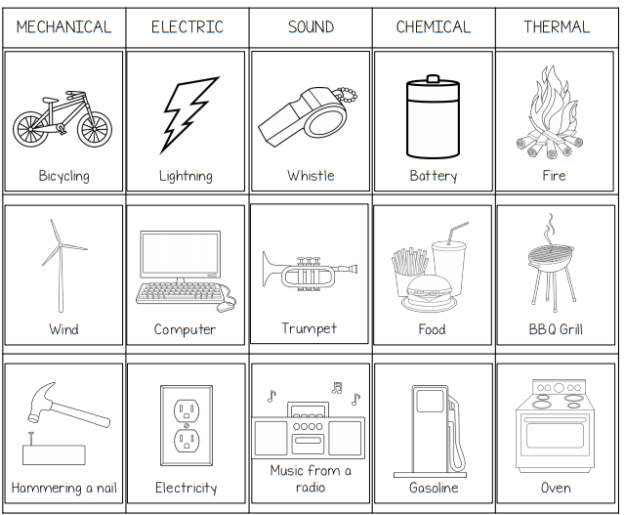
Page 83 ISN

Slide 9
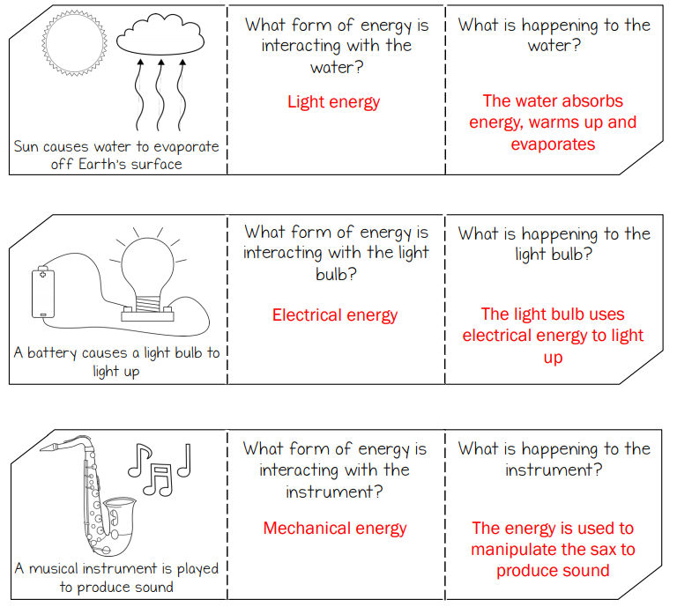
Page 84 ISN

Slide 10
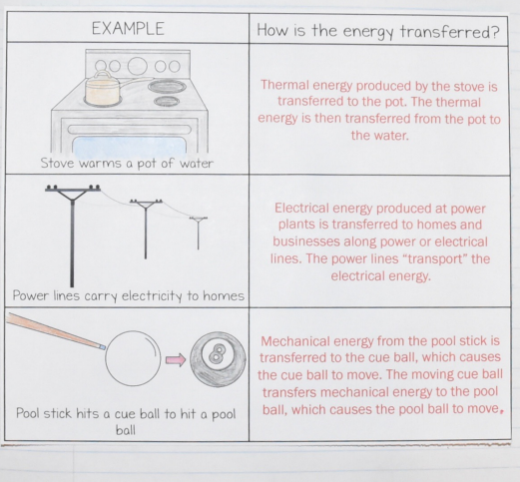
Page 85 ISN

