Slide 1
Date: 2/20/19----UNIT 10 Ecology | HOMEWORK: Vocabulary due Thursday
Please prepare for class. You will need: Planner OUT…or I will sign! | Science Starter: “DO NOWS” PLANNER…Keep planner out on desk….EVERY DAY…ALL DAY! Table of Contents on page 61 for Unit 7 & Unit 10 Page 63 and 64 Unit 10 Lesson 1 Vocabulary….get grade in Focus and get sticker Page 65 Unit 10 Lesson 2 Your planner will be signed if you are not working in class on this. Work on these for the remainder of class.
EQ # 1:
LESSON 1 LESSON 2 Ecology carnivore Population omnivore Ecosystem food web Niche herbivore Biotic factor producer Abiotic factor consumer Species decomposer Biome food chain Community Habitat

Slide 2
Date: 2/22/19----UNIT 10 Ecology POPULATION BREAK-OUT | HOMEWORK: Vocabulary due Thursday
Please prepare for class. You will need: PENCIL & BRAIN | Science Starter: “DO NOWS” PLANNER…Keep planner out on desk….EVERY DAY…ALL DAY! SC.7.L.17.3 Describe and investigate various limiting factors in the local ecosystem and their impact on native populations, including food, shelter, water, space, disease, parasitism, predation, and nesting sites. SC.7.N.1.1 Define a problem from the seventh grade curriculum, use appropriate reference materials to support scientific understanding, plan and carry out scientific investigation of various types, such as systematic observations or experiments, identify variables, collect and organize data, interpret data in charts, tables, and graphics, analyze information, make predictions, and defend conclusions. When you have escaped the classroom, turn in all papers from your group AND your manilla envelope with the 5 white envelopes in Level 1, Level 2 …. Order. Make sure you have completed and turned in your vocabulary after you escape.
BIG IDEA: Plants and animals, including humans, interact with and depend upon each other and their environment to satisfy their basic needs.
LESSON 1 LESSON 2 Ecology carnivore Population omnivore Ecosystem food web Niche herbivore Biotic factor producer Abiotic factor consumer Species decomposer Biome food chain Community Habitat

Slide 3
Date: 2/20/19----UNIT 10 Ecology | HOMEWORK:
Please prepare for class. You will need: Planner OUT…or I will sign! | Science Starter: “DO NOWS” PLANNER…Keep planner out on desk….EVERY DAY…ALL DAY! Hand back papers Unit 10 Vocabulary Bill Nye Populations --- page 66 ISN --- Need sticker for this page
EQ # 1: What is a population? Pg.66
LESSON 1 LESSON 2 Ecology carnivore Population omnivore Ecosystem food web Niche herbivore Biotic factor producer Abiotic factor consumer Species decomposer Biome food chain Community Habitat

Slide 4
Date: 2/20/19----UNIT 10 Ecology | HOMEWORK:
Please prepare for class. You will need: Planner OUT…or I will sign! | Science Starter: “DO NOWS” PLANNER…Keep planner out on desk….EVERY DAY…ALL DAY! Turn in anything you need to ASAP IF you want any kind of credit What’s in an Ecosystem? Page 67 ISN Unit 10 Lesson 2 Vocabulary due tomorrow
EQ # 2: What is an ecosystem? Pg.67
LESSON 1 LESSON 2 Ecology carnivore Population omnivore Ecosystem food web Niche herbivore Biotic factor producer Abiotic factor consumer Species decomposer Biome food chain Community Habitat

Slide 5
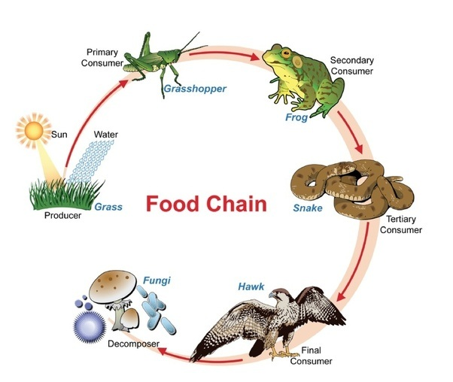
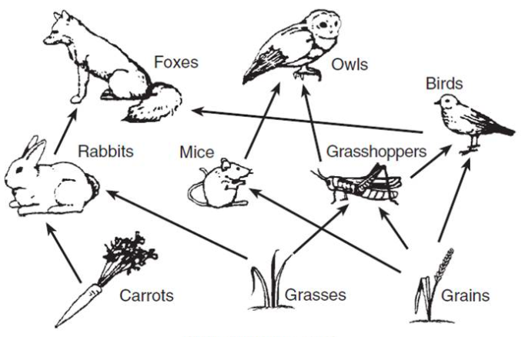
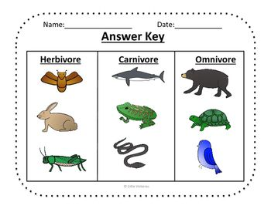
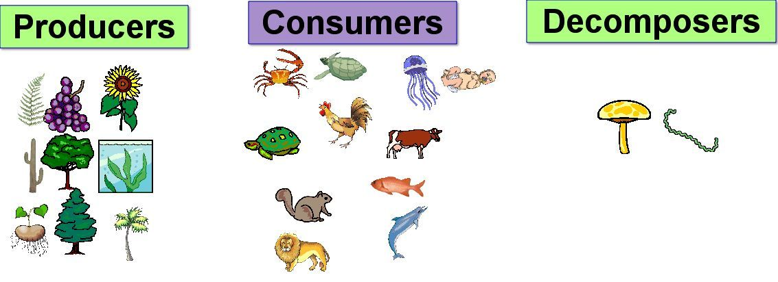

Slide 6
Date: 2/27/19----UNIT 10 Ecology | HOMEWORK:
Please prepare for class. You will need: Planner OUT…or I will sign! | Science Starter: “DO NOWS” PLANNER…Keep planner out on desk….EVERY DAY…ALL DAY! Turn in anything you need to ASAP IF you want any kind of credit Food Chains and Food Webs Unit 10 Lesson 2 Vocabulary due tomorrow
EQ # 2: What is a food chain? Pg.68
LESSON 1 LESSON 2 Ecology carnivore Population omnivore Ecosystem food web Niche herbivore Biotic factor producer Abiotic factor consumer Species decomposer Biome food chain Community Habitat

Slide 7
Date: 2/28/19----UNIT 10 Ecology | HOMEWORK: Study Islands due Sunday, March 3
Please prepare for class. You will need: Planner OUT…or I will sign! | Science Starter: “DO NOWS” PLANNER…Keep planner out on desk….EVERY DAY…ALL DAY! Go to sciencerockswithadkins.weebly.com Find the PowerPoint under “work and answer keys” and complete the paper we began yesterday titled “You Are What You Eat.”---keep this one in your folder. Get paper from Sub “A Pyramid of Energy” Find the PowerPoint on my weebly and fill in the blanks Turn “A Pyramid of Energy” in to the Sub---finished or not. If you complete this, go to Study Island and finish yours. These are due March 3 (Sunday)
EQ # 2: What is a food chain? Pg.68
LESSON 1 LESSON 2 Ecology carnivore Population omnivore Ecosystem food web Niche herbivore Biotic factor producer Abiotic factor consumer Species decomposer Biome food chain Community Habitat

Slide 8
Date: 2/29/19----UNIT 10 Ecology | HOMEWORK:
Please prepare for class. You will need: Planner OUT…or I will sign! | Science Starter: “DO NOWS” PLANNER…Keep planner out on desk….EVERY DAY…ALL DAY! Get your books and tear out pages 536-565 Staple these and put your name and period on them. Work on these completing all questions in the reading, including the Lesson Reviews and Summaries. Turn this in----complete or not!
EQ # 2: What is a food chain? Pg.68
LESSON 1 LESSON 2 Ecology carnivore Population omnivore Ecosystem food web Niche herbivore Biotic factor producer Abiotic factor consumer Species decomposer Biome food chain Community Habitat

Slide 9
Date: 3/04/19----UNIT 10 Ecology | HOMEWORK:
Please prepare for class. You will need: Planner OUT…or I will sign! | Science Starter: “DO NOWS” PLANNER…Keep planner out on desk….EVERY DAY…ALL DAY! Unit 10 Lesson 3 Vocab. Sheet page 74 (7 words) Unit 10 Lesson 3 Definitions w/ pics page 75 Unit 10 lesson 4 Vocab. Sheet page 76 (6 words) Unit 10 Lesson 4 Definitions no pics page 77 Come get stickers as you need them.
EQ # 2: What is a food chain? Pg.68
LESSON 1 LESSON 2 Predator limiting factor Mutualism wetland Competition native species Prey estuary Symbiosis coral reef commensalism

Slide 10
Date | Standard | Topic ----- UNIT 5 | Page
1/8/19 | **** (7 * total) | TOC --- Table of Contents | 51
1/8/19 |  | Unit 5 Vocabulary Sheet (Green) | 52
1/8/19 | **** | Unit 5 Lesson 1 Vocabulary | 53
1/8/19 | **** | Unit 5 Lesson 2 Vocabulary | 54
1/19/19 | **** | Waves Doodle Notes | 55
1/20/19 |  | Unit 5 Lessons 3 & 4 Vocabulary Sheet (Orange) | 56
1/20/19 | **** | Unit 5 Lesson 3 Vocab. Definitions | 57
1/20/19 | **** | Unit 5 Lesson 4 Vocab. Definitions | 58
1/21/19 | **** | Electromagnetic Spectrum | 59

Slide 11
Date | Standard | Topic ----- UNIT 7 & 10 | Page
2/5/19 | ** Later | TOC --- Table of Contents | 61
2/5/19 | **** (13 as of 3-4) | Unit 7 Vocabulary Definitions (9) | 62
2/20/19 |  | Unit 10 Lesson 1 Vocabulary Sheet (green) | 63
2/20/19 | **** | Unit 10 Lesson 1 Definitions | 64
2/20/19 | **** | Unit 10 Lesson 1 Definitions | 65
2/25/19 | **** | Bill Nye Populations | 66
2/26/19 | **** | What’s in an Ecosystem? Bellwork | 67
2/26/19 | **** | What’s in an Ecosystem? PP Worksheet | 68
2/26/19 |  | U 10 L 2 Vocabulary Sheet (yellow) | 69
2/26/19 | **** | U10 L2 Vocabulary Definitions | 70
2/27/19 | **** | You are what you eat! PP Bellwork | 71
2/27/19 | **** | You are what you eat! PP Worksheet | 72
2/28/19 | **** | A pyramid of energy PP Bellwork | 73
3/4/19 |  | U10 L3 Vocabulary Sheet (7 words) | 74
3/4/19 | **** | U10 L3 Vocabulary Definitions | 75

Slide 12
Date | Standard | Topic ----- UNIT 7 & 10 | Page
3/4/19 |  | U10 L4 Vocabulary Sheet (6 words) | 76
3/4/19 | **** | U10 L4 Vocabulary Definitions | 77
2/28/19 | **** | A Pyramid of Energy PP Worksheet | 78

Slide 13
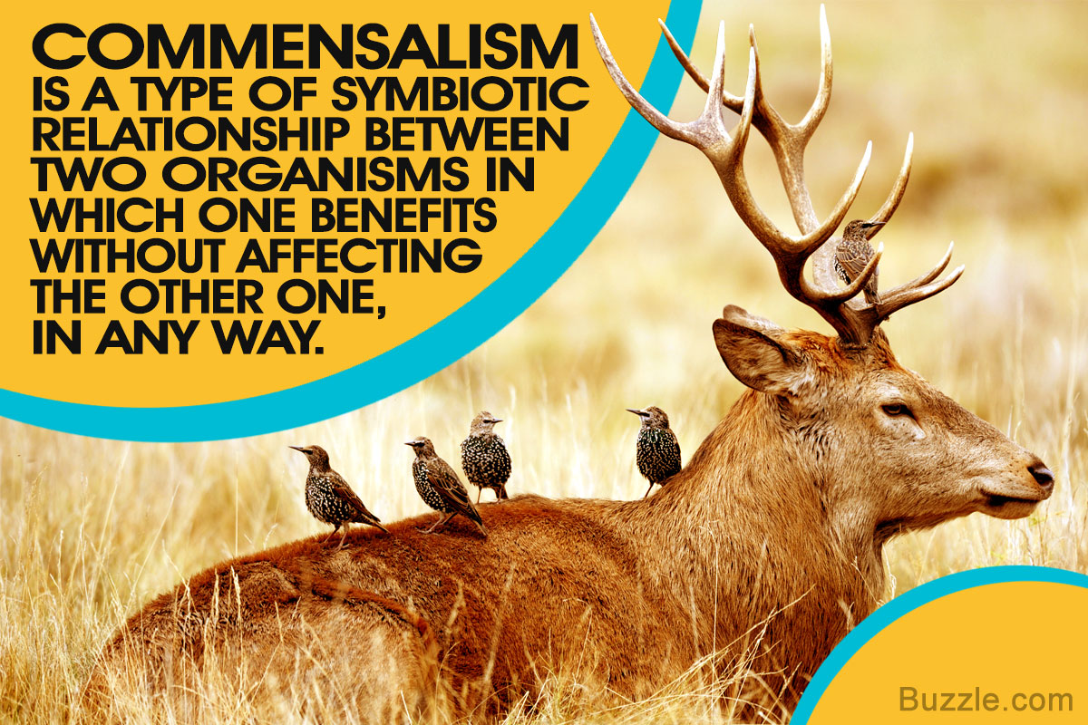
Unit 10 Lesson 3 Pics

