Slide 1
Benchmark Review – 2019 Answers will be on the page after the question
.

Slide 2
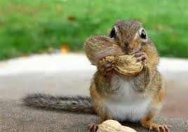
1. You are investigation what type of nuts that squirrels prefer. Your dependent variable is the number of squirrels coming to eat. What would the independent variable be?
.

Slide 3
2. What variable is purposely changed to test a hypothesis?
1. ANS: The I.V. would be the type of nuts you used.

Slide 4
3. What is the electromagnetic spectrum?
2. ANS: The independent variable.

Slide 5
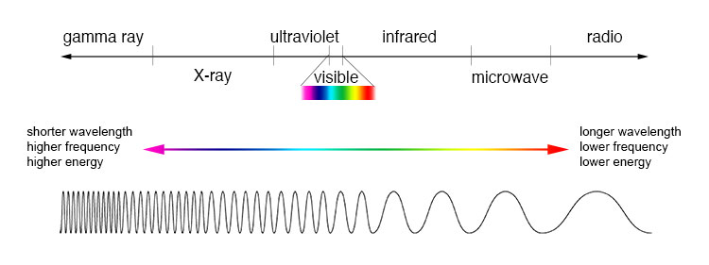
4. Which electromagnetic waves have the longest wavelengths and lowest frequencies?
3. ANS: The electromagnetic spectrum is the range of electromagnetic waves placed in a certain order.

Slide 6
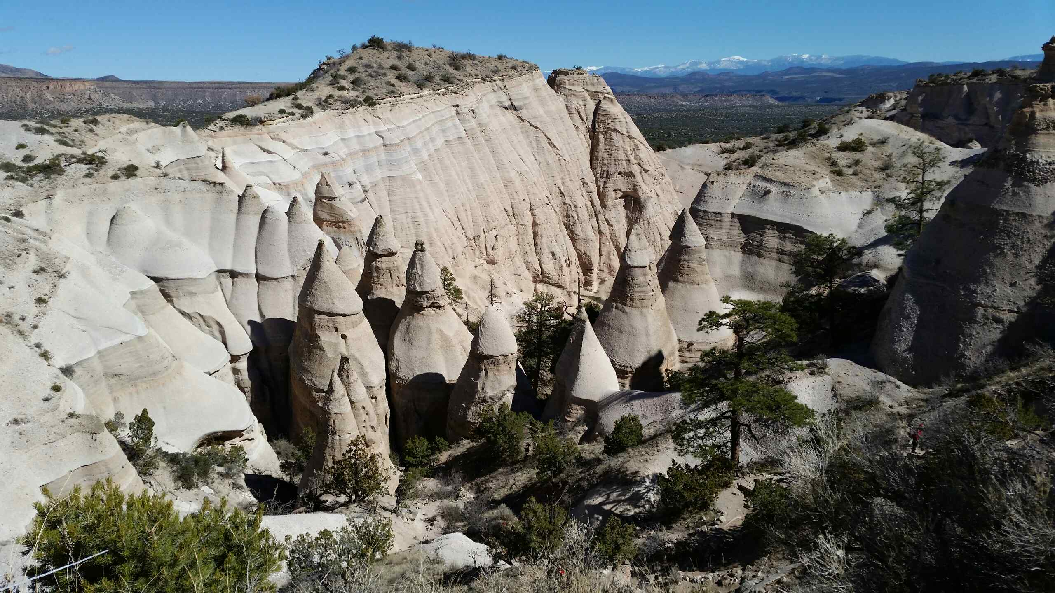
5. What is the relative age of a rock?
4. ANS: Radio waves have the longest wavelengths and the lowest frequencies.

Slide 7
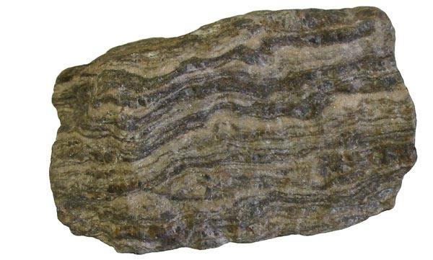
6. what is a metamorphic rock?
5. ANS: The relative age of a rock is its age compared with the ages of other rocks.

Slide 8
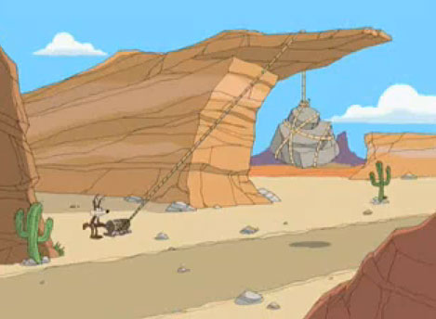
7. Name several useful metamorphic rocks.
6. ANS: Metamorphic rocks arise from the transformation of existing rock types, in a process called metamorphism, which means "change in form". The original rock is subjected to heat and pressure, causing profound physical or chemical change.

Slide 9
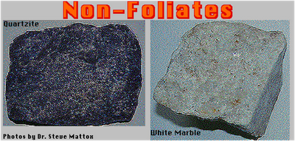
8. What is a non-foliated metamorphic rock?
7. ANS: Marble, Gneiss, Slate, Quartzite

Slide 10
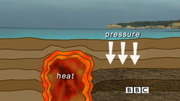
9. Heat and pressure deep in the earth can change any type of rock into what?
8. ANS: They do not have a layered or banded appearance.

Slide 11
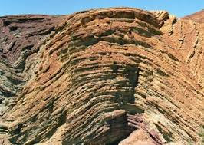
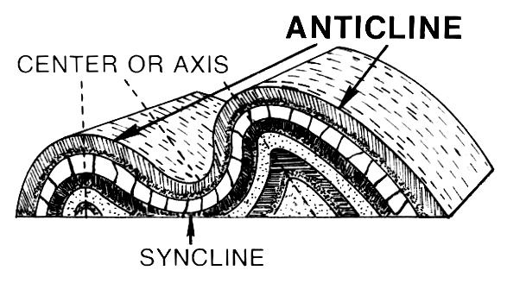
10. What is an anticline?
9. ANS: Metamorphic Rock

Slide 12
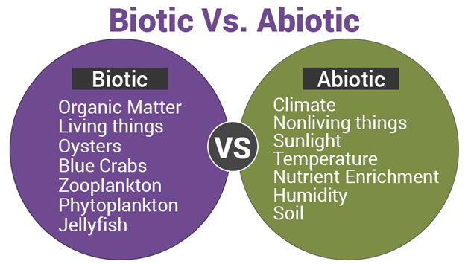
11. What are abiotic factors?
10. ANS: A fold in rock that bends upward into an arch is called an anticline.

Slide 13
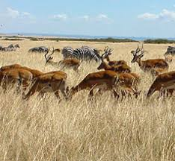
12. What is a population?
11. ANS: The non-living parts of an ecosystem.

Slide 14
13. What is a habitat?
12. ANS: A population is all the members of one species living in a particular area.

Slide 15
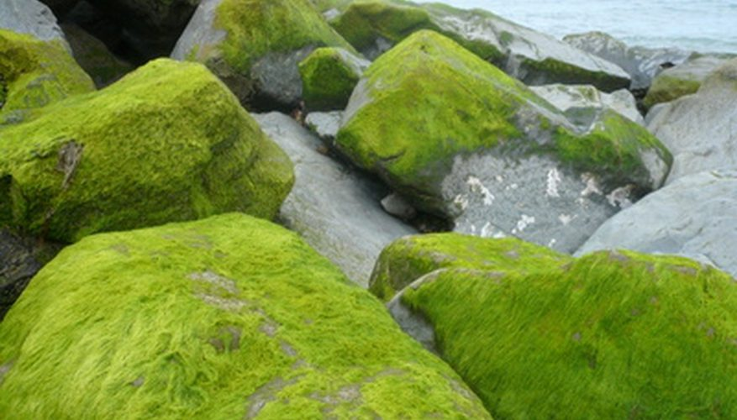
14. What abiotic factors do algae and plants use to help them produce their own food?
13. ANS: A habitat is a place where an organism lives and that provides the things the organism needs.

Slide 16
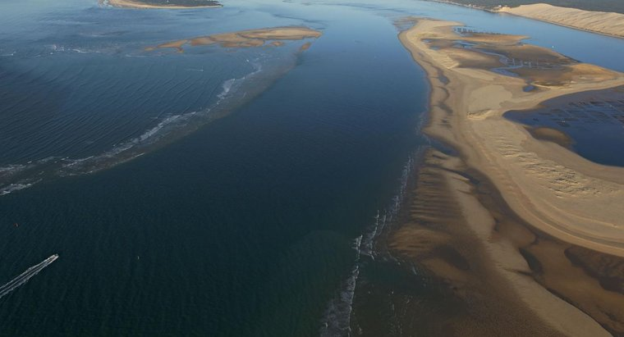
15. What is deposition?
14. ANS: sunlight, carbon dioxide and water

Slide 17
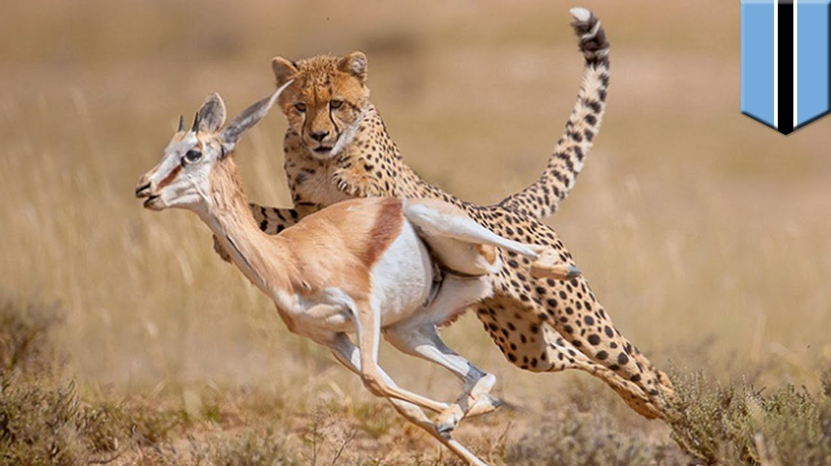
16. What are predators?
15. ANS: Deposition is the process by which sediment settles out of the water or the wind carries it and deposits it.

Slide 18
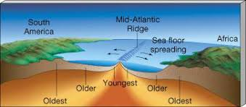
17. What is sea-floor spreading?
16. ANS: wild animals that hunt, or prey on, other animals.

Slide 19
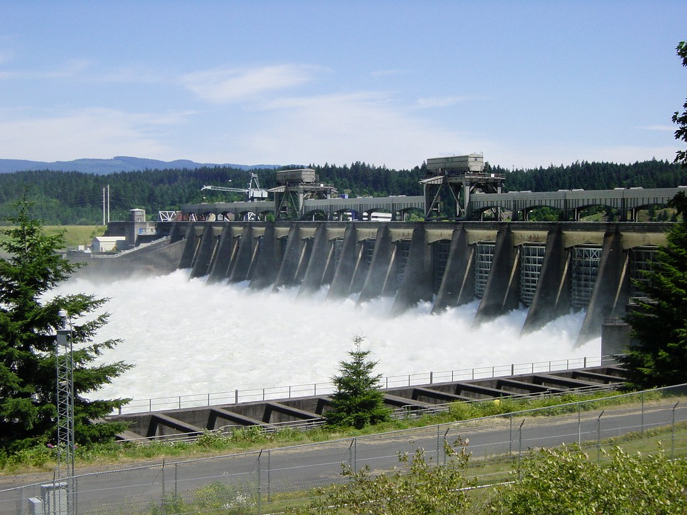
18. In a hydroelectric plant, the mechanical energy in moving water is transformed into what type of energy?
17. ANS: Seafloor spreading is a process that occurs at mid-ocean ridges, where new oceanic crust is formed through volcanic activity and then gradually moves away from the ridge.

Slide 20
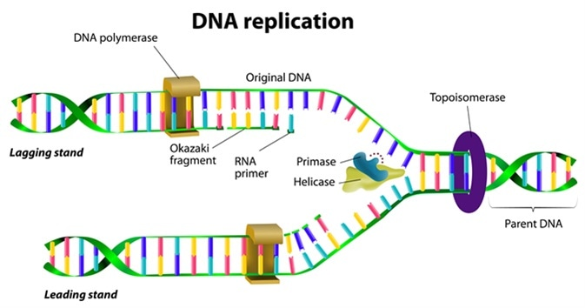
19. What is Dna replication?
18. ANS: electrical energy

Slide 21
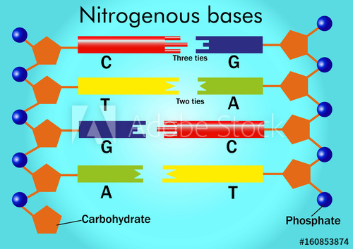
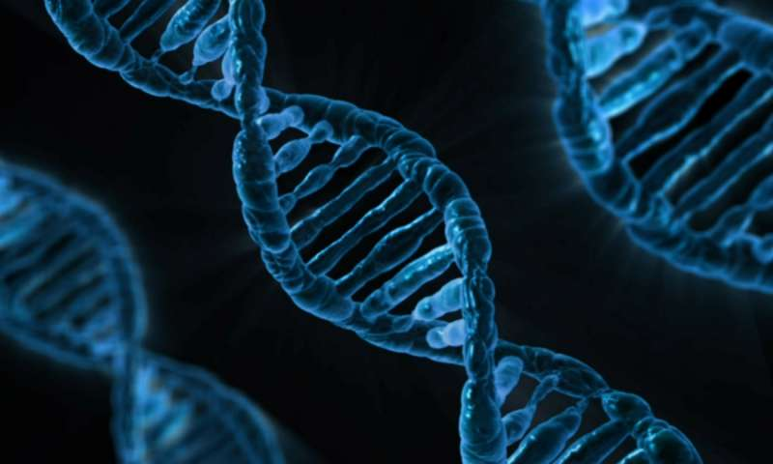
20. During replication of DNA, what does cytosine always pair with? What does adenine always pair with?
19. ANS: the process by which DNA makes a copy of itself during cell division.

Slide 22
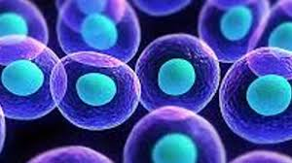
21. How do cells obtain energy in organisms?
20. ANS: Cytosine pairs with Guanine (C – G) Adenine pairs with Thymine (A – T)

Slide 23
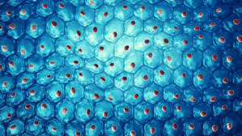
22. cells break bonds to obtain energy. Breaking bonds releases _____________.
21. ANS: Cells obtain energy by breaking bonds.

Slide 24
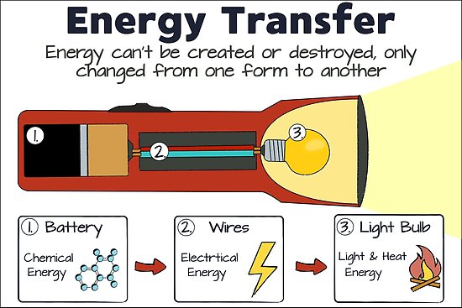
23. When energy is transformed from one form to another, what happens to the total energy?
22. ANS: Breaking bonds releases chemical energy.

Slide 25
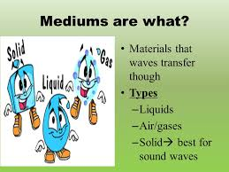
24. Name 3 mediums that sound can travel through.
23. ANS: the total energy is conserved

Slide 26
25. In which medium does sound travel the fastest?
24. ANS: air, water, steel ---- solids, liquids and gases

Slide 27
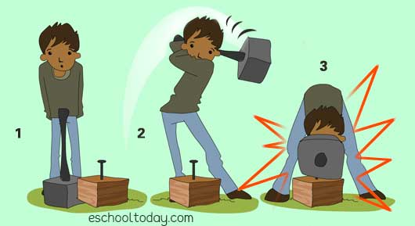
26. How is mechanical energy calculated?
25. ANS: Steel

Slide 28
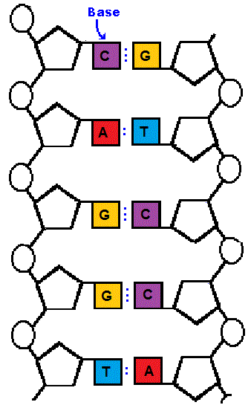
27. What does the order of nitrogen bases along a gene determine?
26. ANS: KE + PE = ME -------- Kinetic Energy + Potential Energy = Mechanical Energy

Slide 29
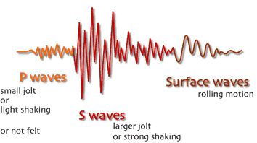
28. What are “S” waves?
27. ANS: it determines the type and order of amino acids added to a protein

Slide 30
28. ANS: S-waves, secondary waves, or shear waves (sometimes called an elastic S-wave) are a type of elastic wave, and are one of the two main types of elastic body waves, so named because they move through the body of an object, unlike surface waves.

