Slide 1
A Pyramid of Energy!
Objective: to determine how much energy is transferred or lost in an ecosystem.
Bell work: 2/29/19
Write ?’s & Answers page 73
What is the source of all energy?
Why are decomposers considered nature’s recyclers?
The sun
They break down organic materials and return them to the Earth
© Getting Nerdy, LLC

Slide 2
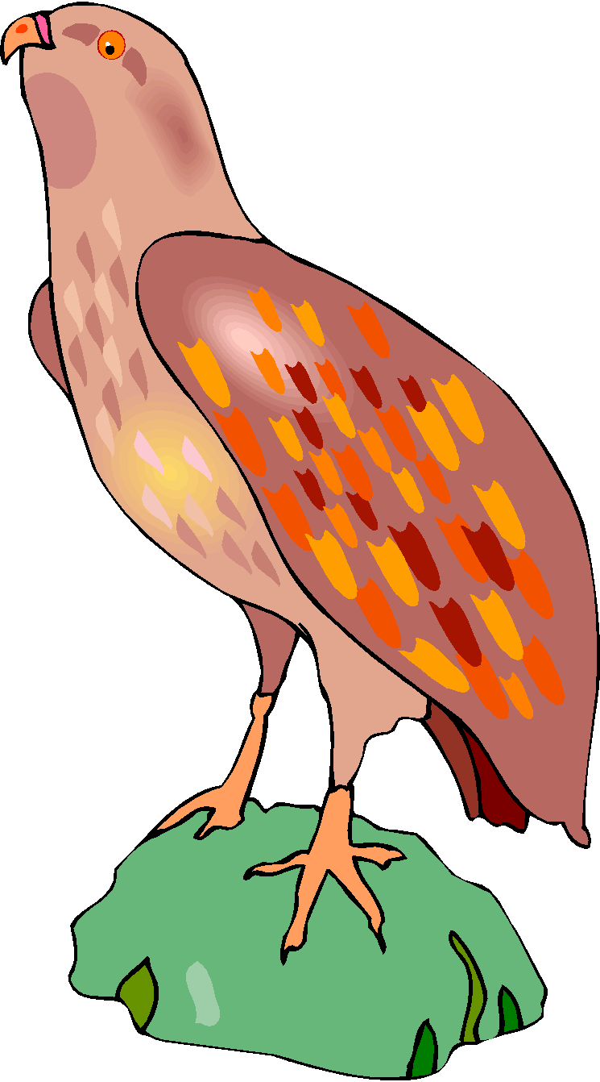
Energy Pyramid
The sun is the ultimate source of energy for all living organisms
The sun provides energy directly to producers and indirectly to herbivores, omnivores and carnivores.
As you go up the food chain/energy pyramid, the amount of available energy decreases because you are getting further away from the original source of energy, the sun.
It takes a large number of producers to provide enough energy to a small number of primary consumers
It takes a large number of primary consumers to provide enough energy to a small number of secondary consumers
It takes a large number of secondary consumers to provide enough energy to a small number of tertiary consumers
© Getting Nerdy, LLC

Slide 3
Time for some Energy Transfer!
…We are going to calculate the amount of energy is transferred from the ULTIMATE source of all energy to the 3rd consumer…
We will start with…
© Getting Nerdy, LLC

Slide 4
THE SUN
Provides the energy for producers to conduct photosynthesis and make food.
ENERGY IN: 1000 units
© Getting Nerdy, LLC

Slide 5
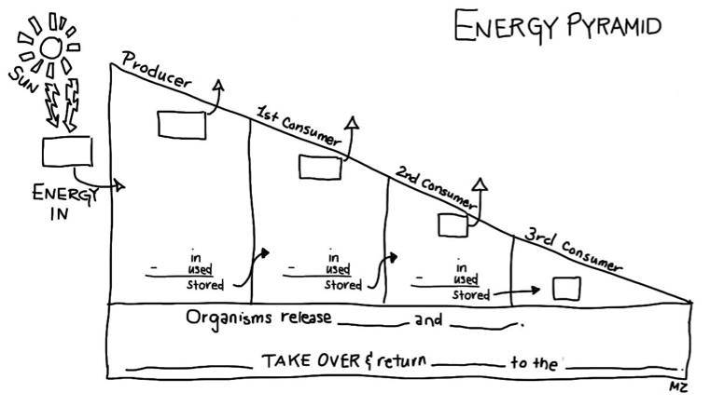
1000
Fill in your chart with your calculations as we move along! Draw pictures neatly and color each one!
© Getting Nerdy, LLC

Slide 6
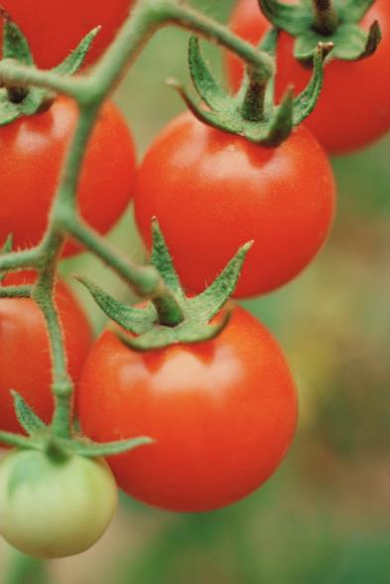
PRODUCER
A tomato plant gets the 1000 units IN. It uses 900 of those 1000 units to power its daily activities. Much of that energy is lost to the activities & surroundings. How much of the original energy is STORED?
© Getting Nerdy, LLC

Slide 7
900
1000
A. Tomato Plant
1000
900
100
Fill in your chart with your calculations as you see here! Draw your picture neatly and color it!
© Getting Nerdy, LLC

Slide 8
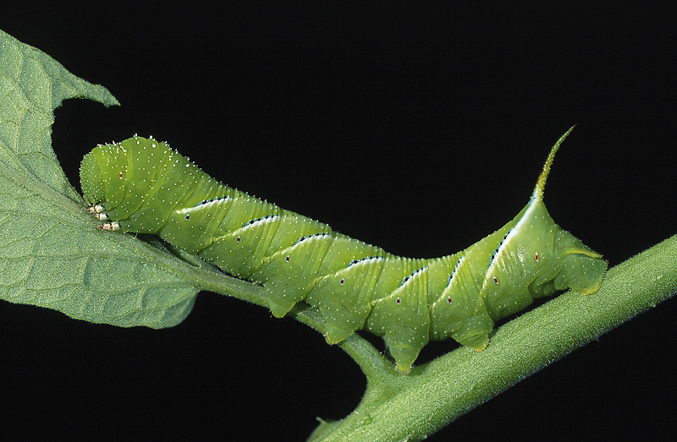
PRIMARY (1st) CONSUMER
The tomato hornworm loves tomatoes. When it eats the tomato, it only receives the energy stored – 100 UNITS. Of the 100 units of ENERGY IN, 90 units are used to power the worm’s daily activities and much of that energy is lost to the activities & surroundings. How much of the original energy is STORED?
© Getting Nerdy, LLC

Slide 9
900
1000
A. Tomato Plant
90
B. Hornworm
1000
100
900
90
100
10
Fill in your chart with your calculations as you see here! Draw your picture neatly and color it!
© Getting Nerdy, LLC

Slide 10
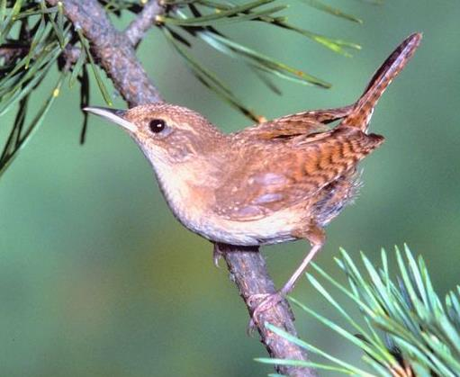
SECONDARY (2nd) CONSUMER
A Carolina Wren is flying up above and makes a tasty meal out of the hornworm, getting the 10 units of stored energy. Of the 10 units of ENERGY IN, 9 units are used to power the wren’s daily activities and much of that energy is lost to the activities & surroundings. How much of the original energy is STORED?
© Getting Nerdy, LLC

Slide 11
900
1000
A. Tomato Plant
90
B. Hornworm
9
1000
100
C. Wren
900
90
10
100
10
9
1
Fill in your chart with your calculations as you see here! Draw your picture neatly and color it!
© Getting Nerdy, LLC

Slide 12
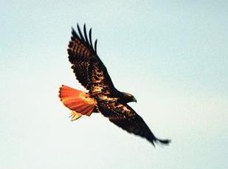
TERTIARY (3rd) CONSUMER
A Red-tail Hawk is circling the field and sees the wren flying below. It swoops down to catch his meal, getting the 1 unit of stored energy as he eats it.
© Getting Nerdy, LLC

Slide 13
900
1000
A. Tomato Plant
90
B. Hornworm
9
1000
100
C. Wren
900
90
10
D. Red-tail Hawk
100
10
9
1
1
Your finished energy pyramid should look like this with pictures drawn and calculations complete!
© Getting Nerdy, LLC

Slide 14
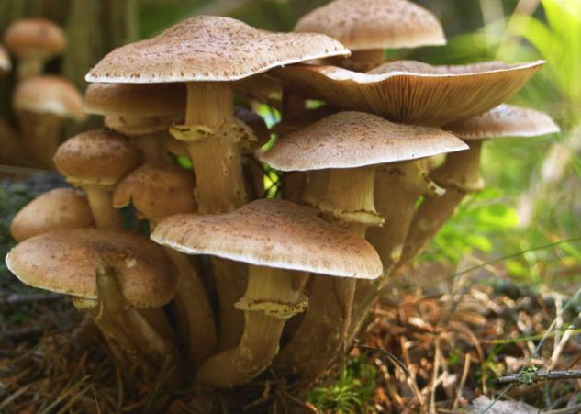
Conclusion: As you move up the energy pyramid, only __% of the energy is transferred to the next level.
Organisms release waste and die. Decomposers take over and return nutrients to the earth.
THINK: If a tertiary consumer died, how much energy would be left for the decomposers?
0.1
10
© Getting Nerdy, LLC

